Slide 2
v
START UP OF AGRICULTURAL ACTIVITIES
IN SUPPORT OF
WOMEN HEADS OF HHS IN RURAL IDLIB
“For a sound mind and a sound body”

Slide 3
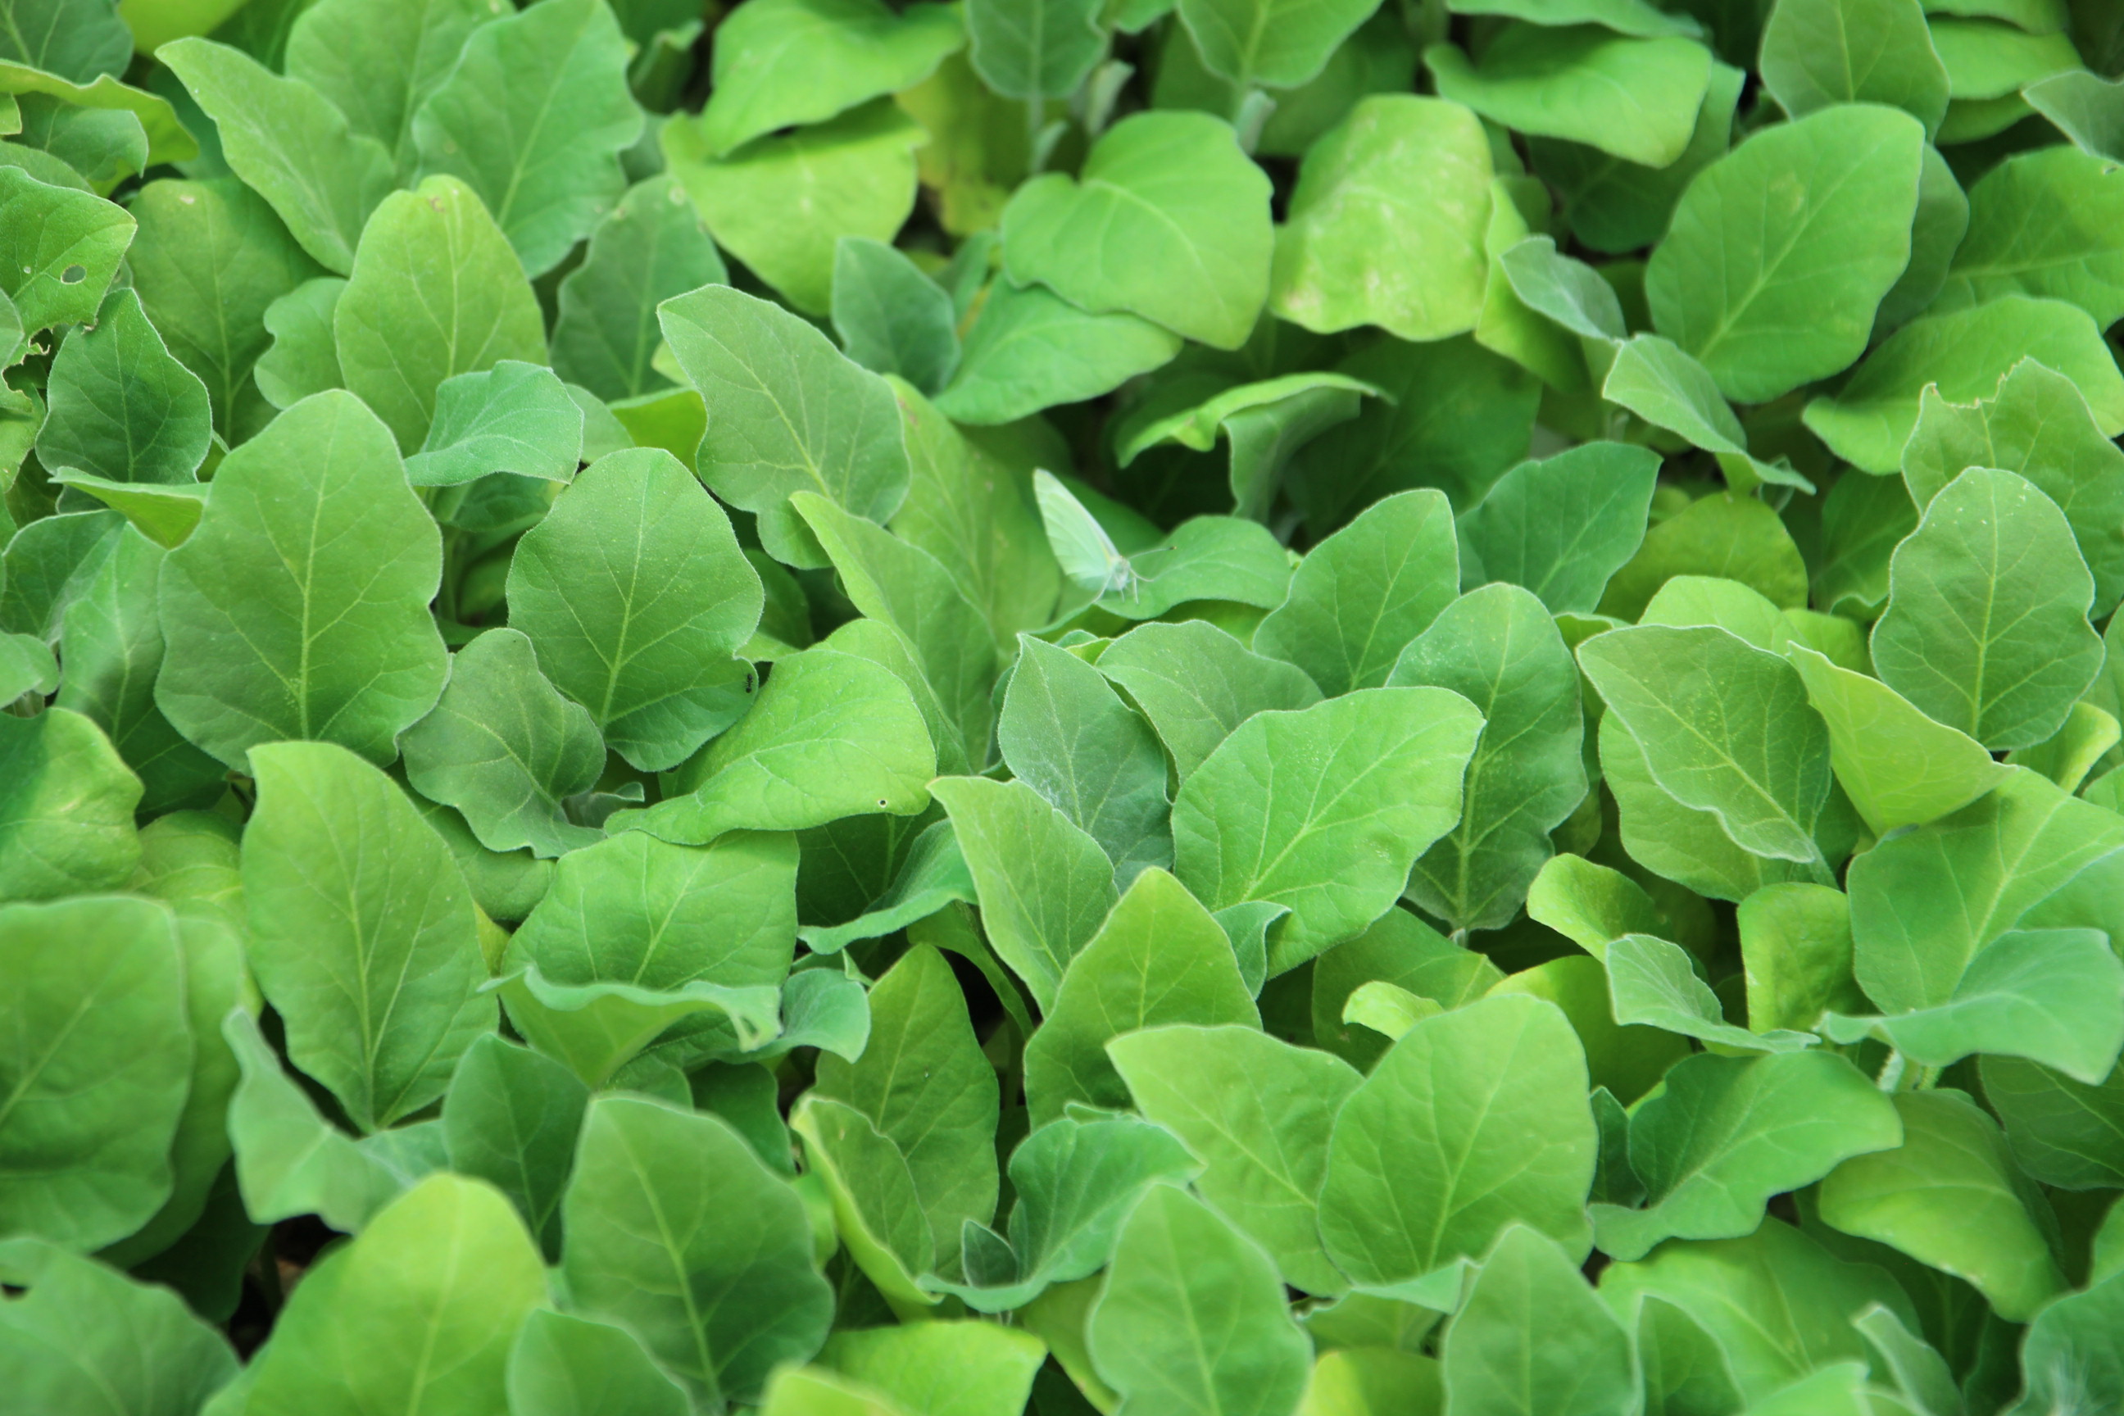
Timeframe:
8 MOUNTH
Start date: 10/Apr/2017
End date: 09/Dec/2017
PROJECT TARGET: Sustainable development for vulnerable female-headed families to get income from dairy products, and agricultural crops.
Location: Southern countryside of IDLIB (Kafer-rumah, Kafer-sajnah, alnaqeer, alrakaya.

Slide 4
v
ACTIVITIES

Slide 5
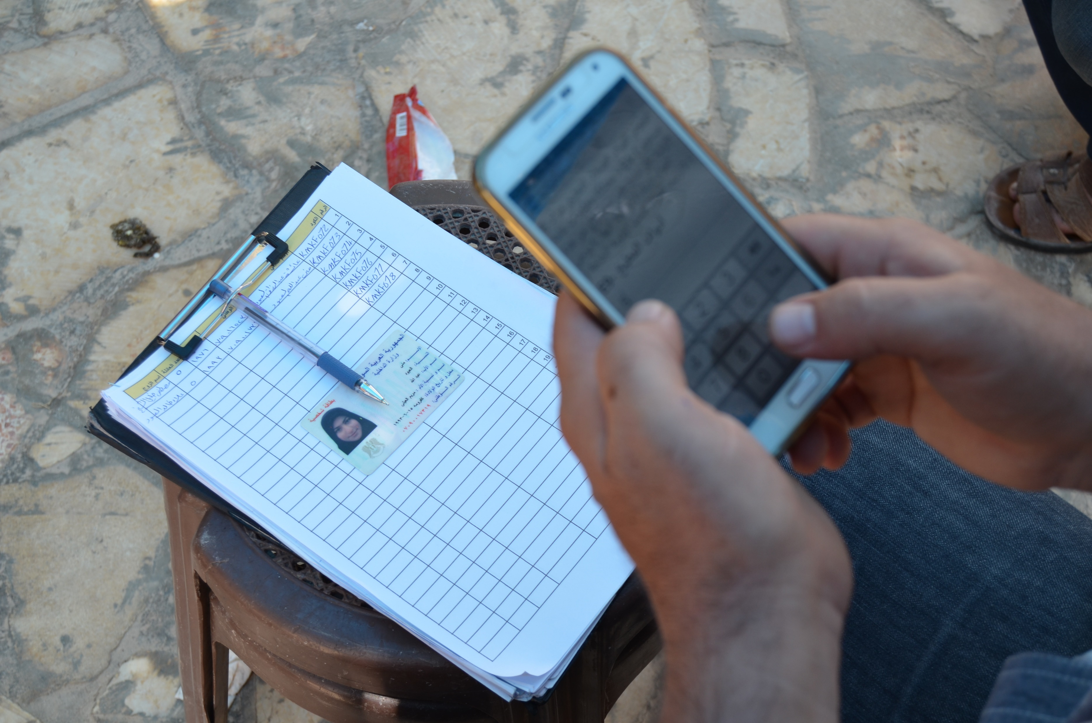
ACTIVITIES OF THE PROJECT
1) Field survey
A field survey was carried out and real information was collected from the beneficiaries via elaborate questionnaires in order to define the most deserving families.
540 female beneficiaries have met the project’s criteria
(Women who are taking care of children under 18, adults over 80 or family members with disabilities/chronic diseases l women with less or no source of income)

Slide 6
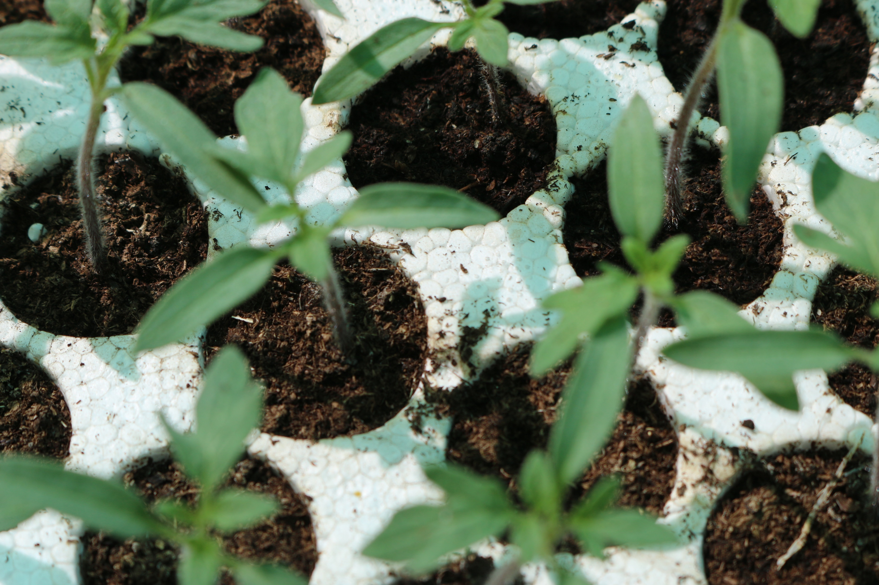
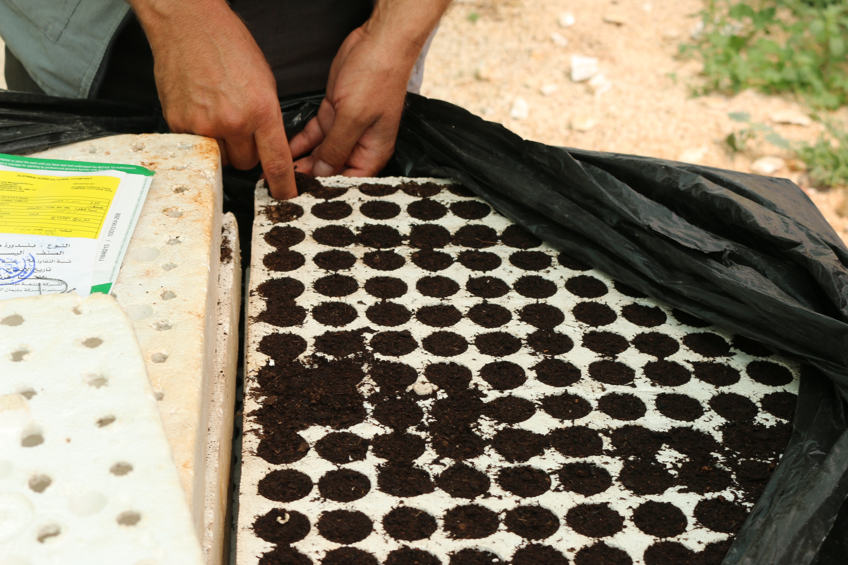
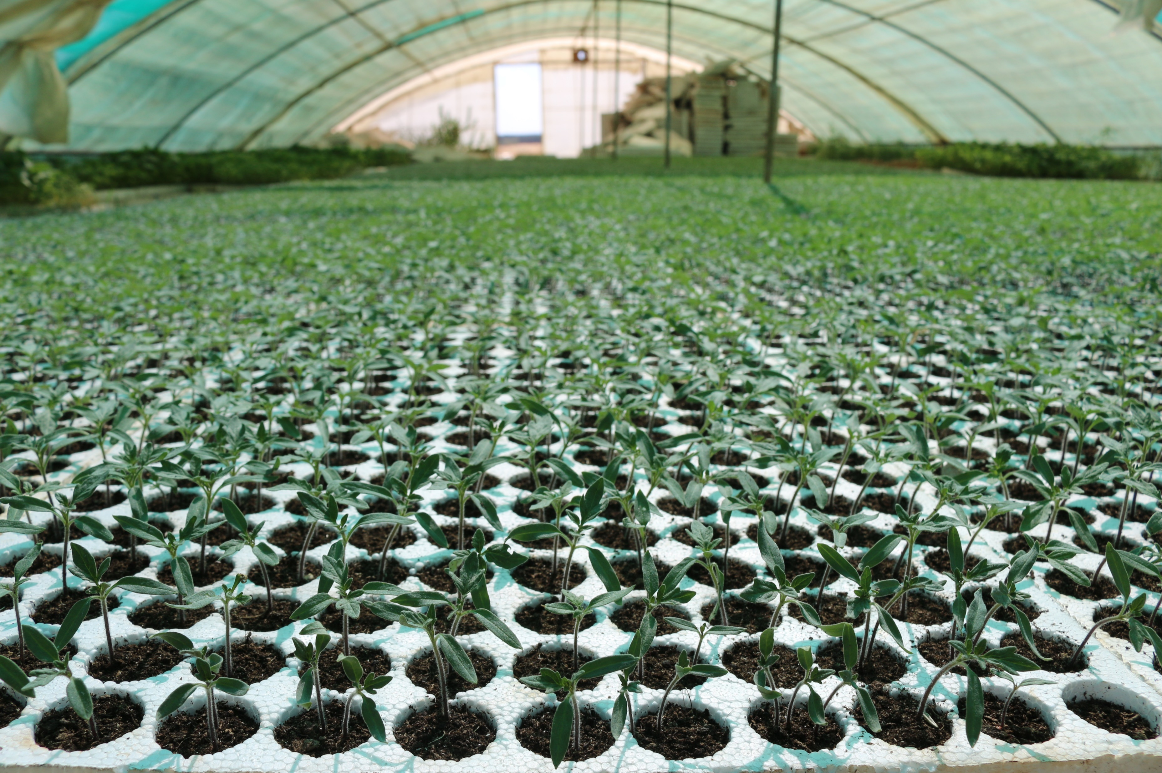
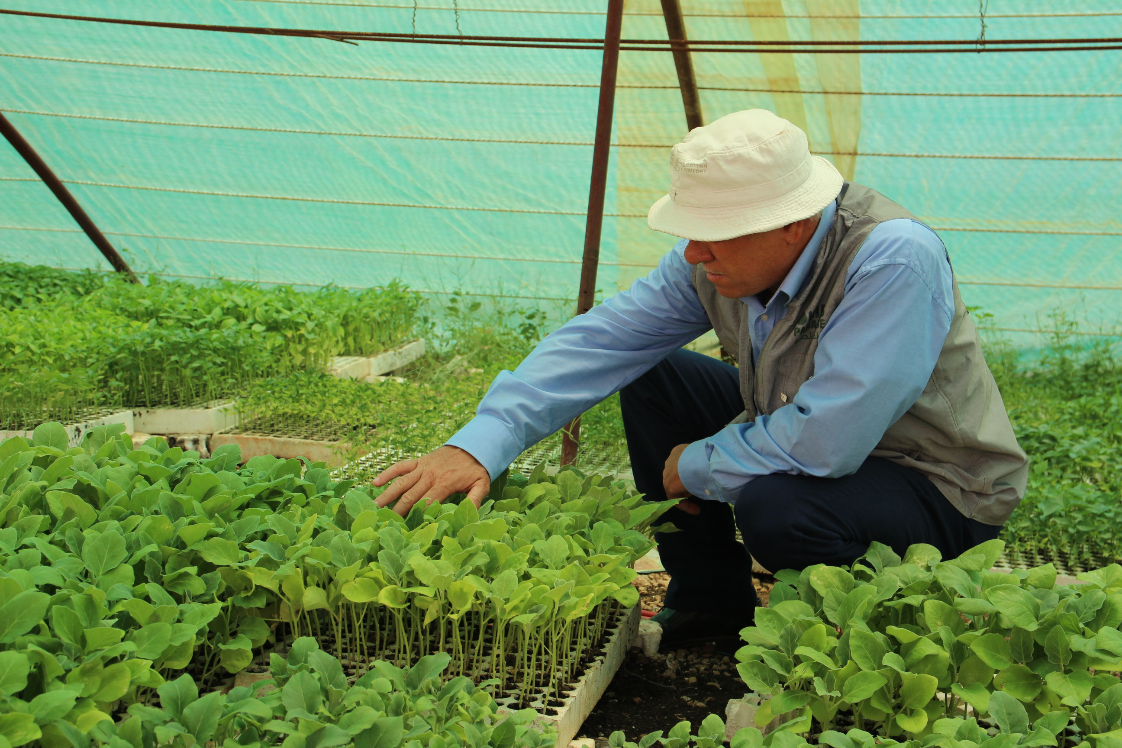
ACTIVITIES OF THE PROJECT
2) Growing seedlings from seeds
To ensure the quality of production, seedlings were grown by agricultural specialists in a big plantation to be moved later to the 180 greenhouses

Slide 7
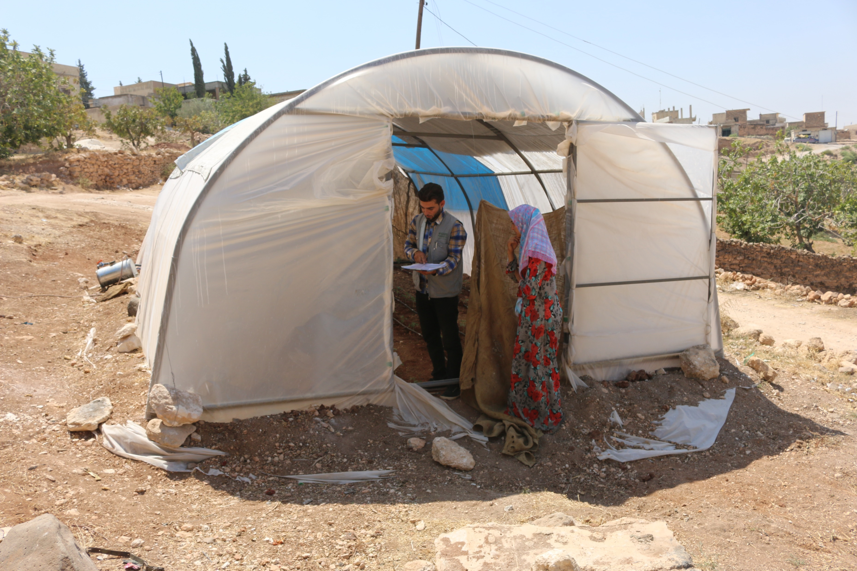
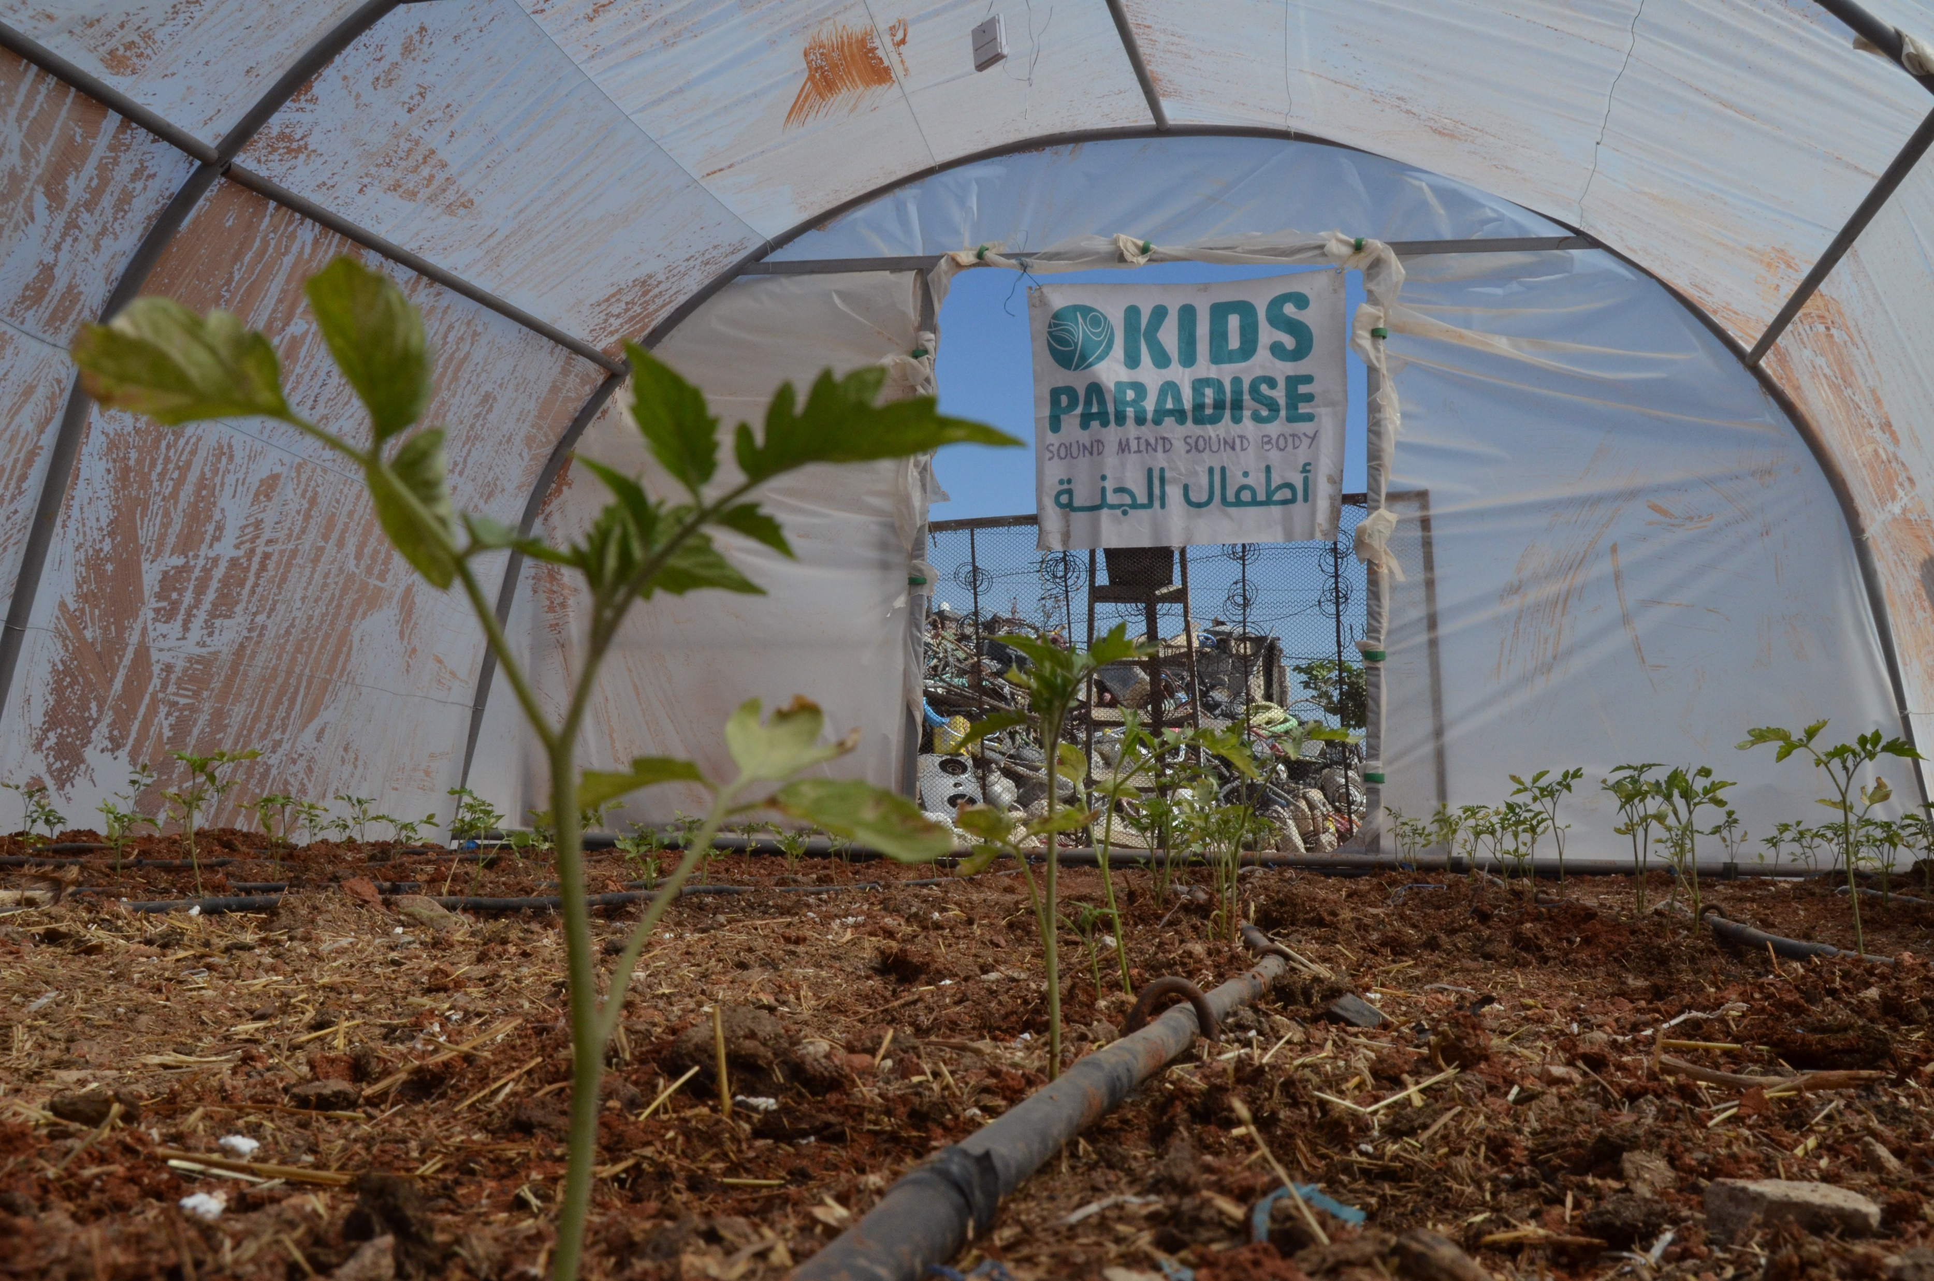
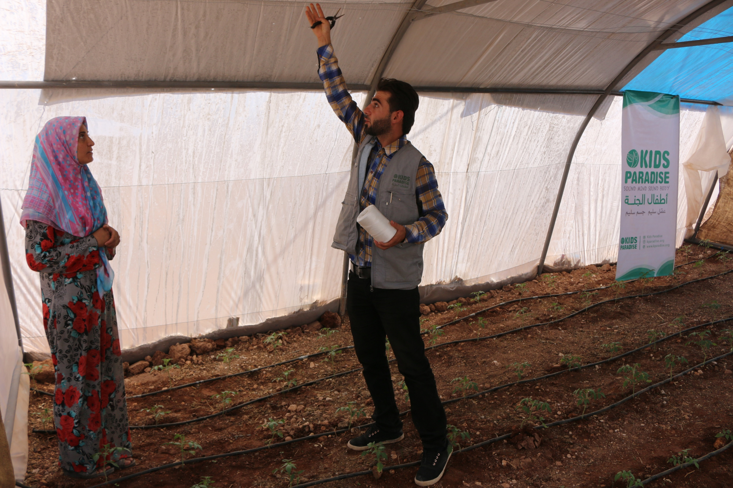
ACTIVITIES OF THE PROJECT
3) Distribution of greenhouses:
180 greenhouses were distributed to 180 families including (Agricultural tools, drip-irrigation system, regular water trucking)

Slide 8
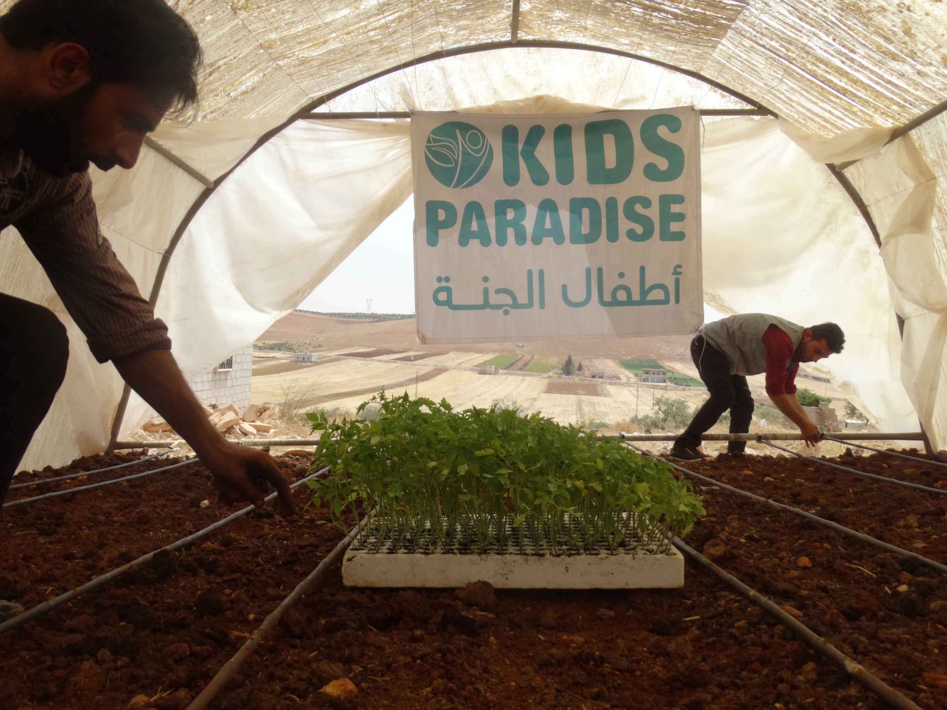
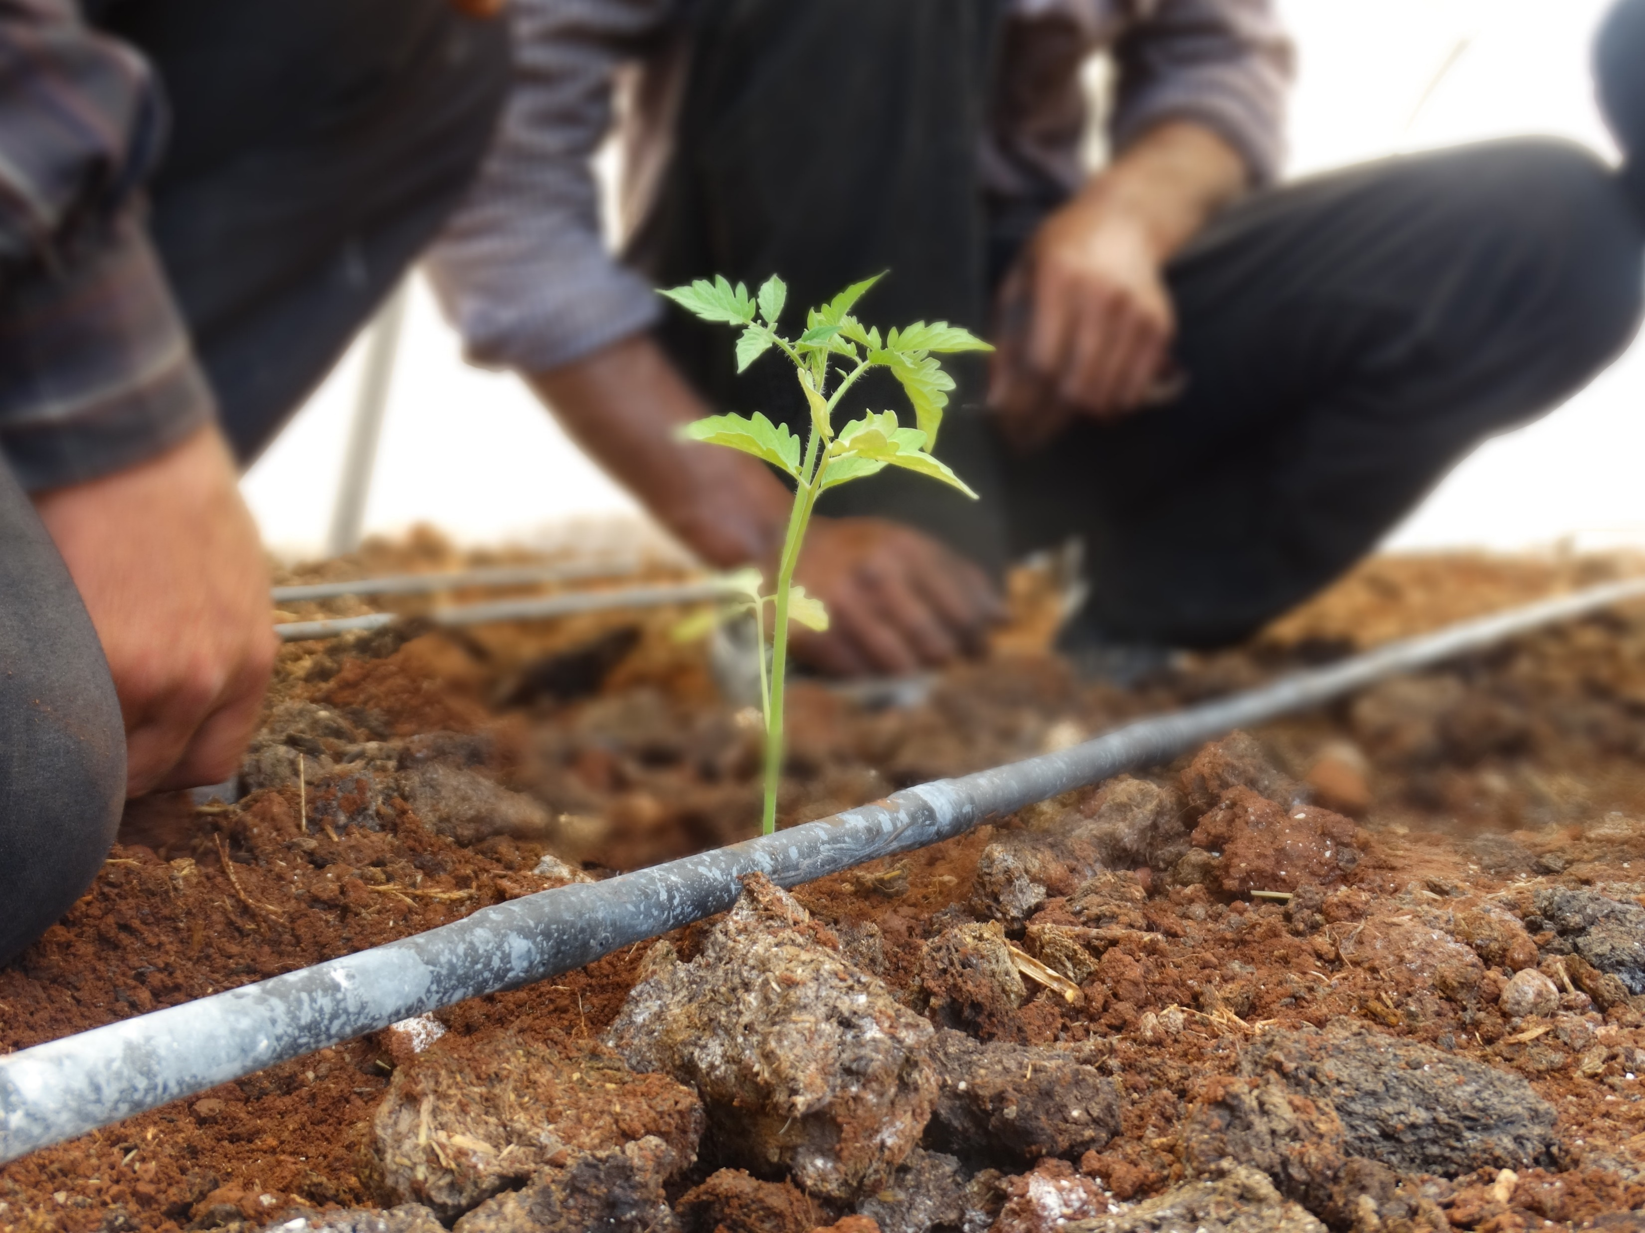
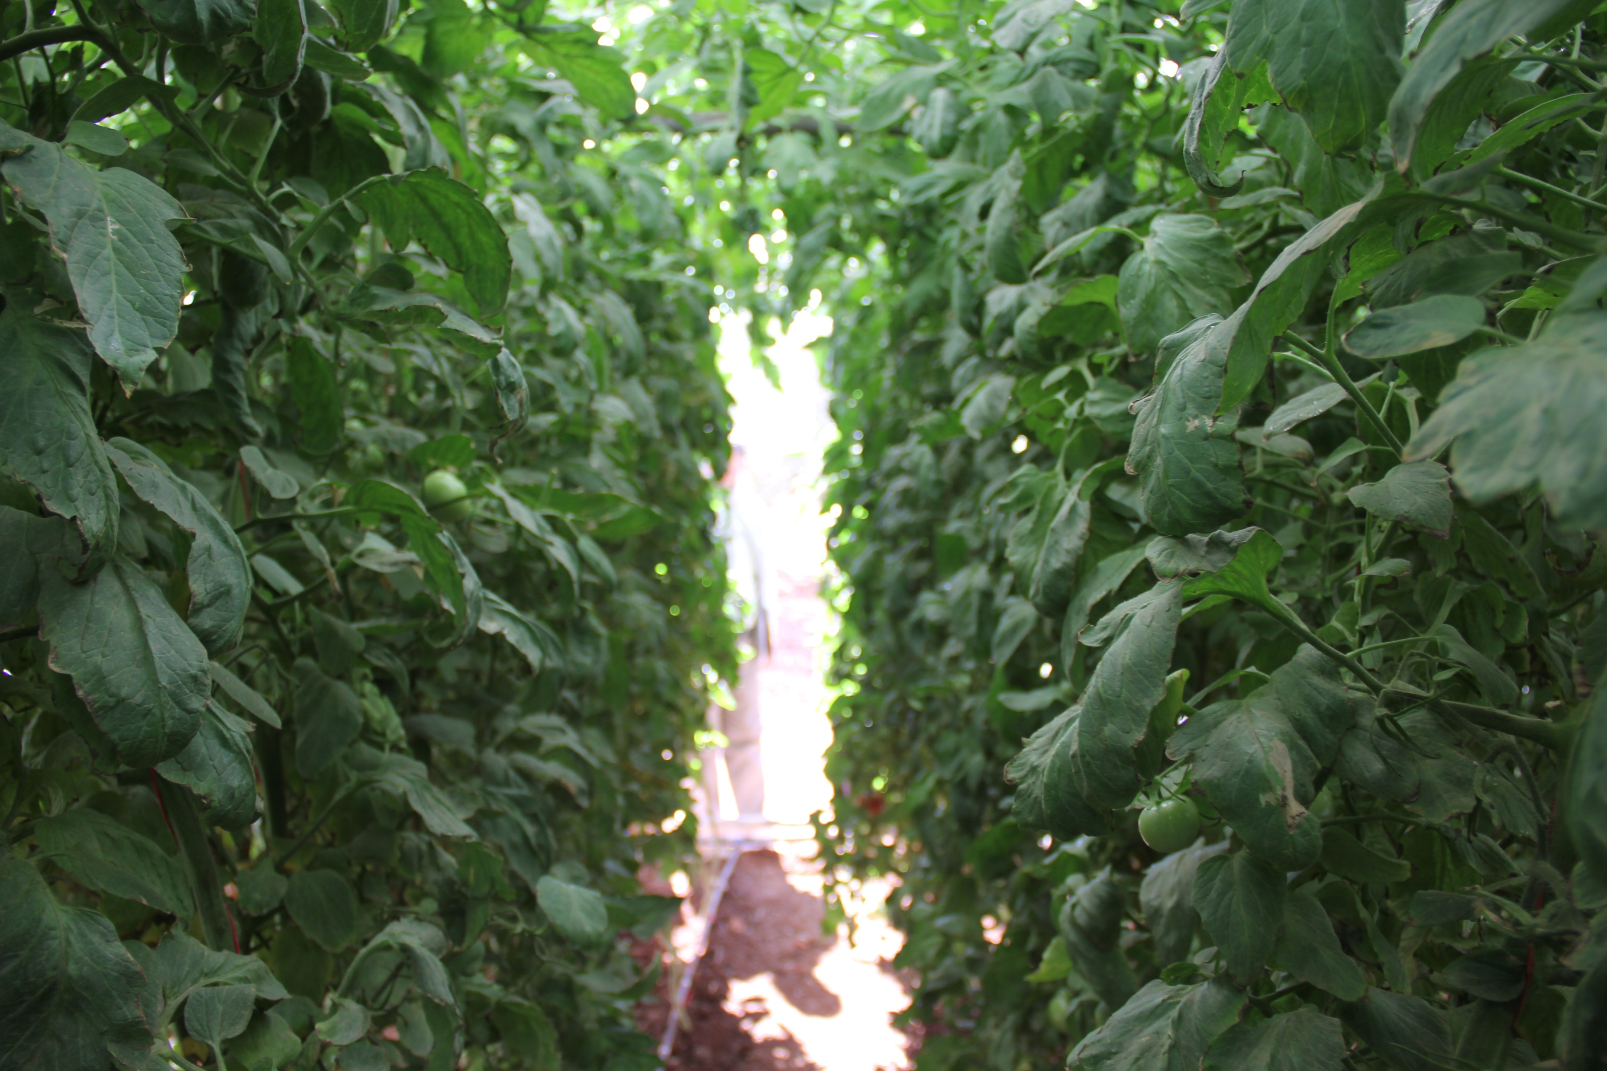
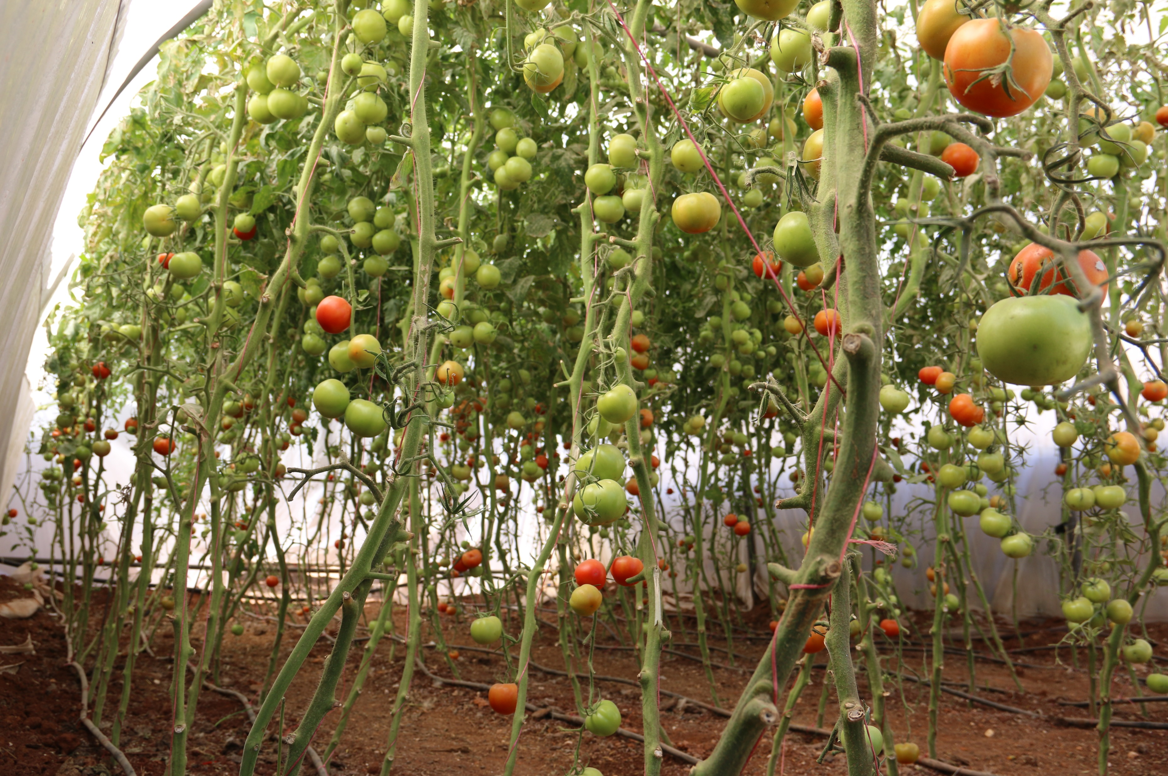
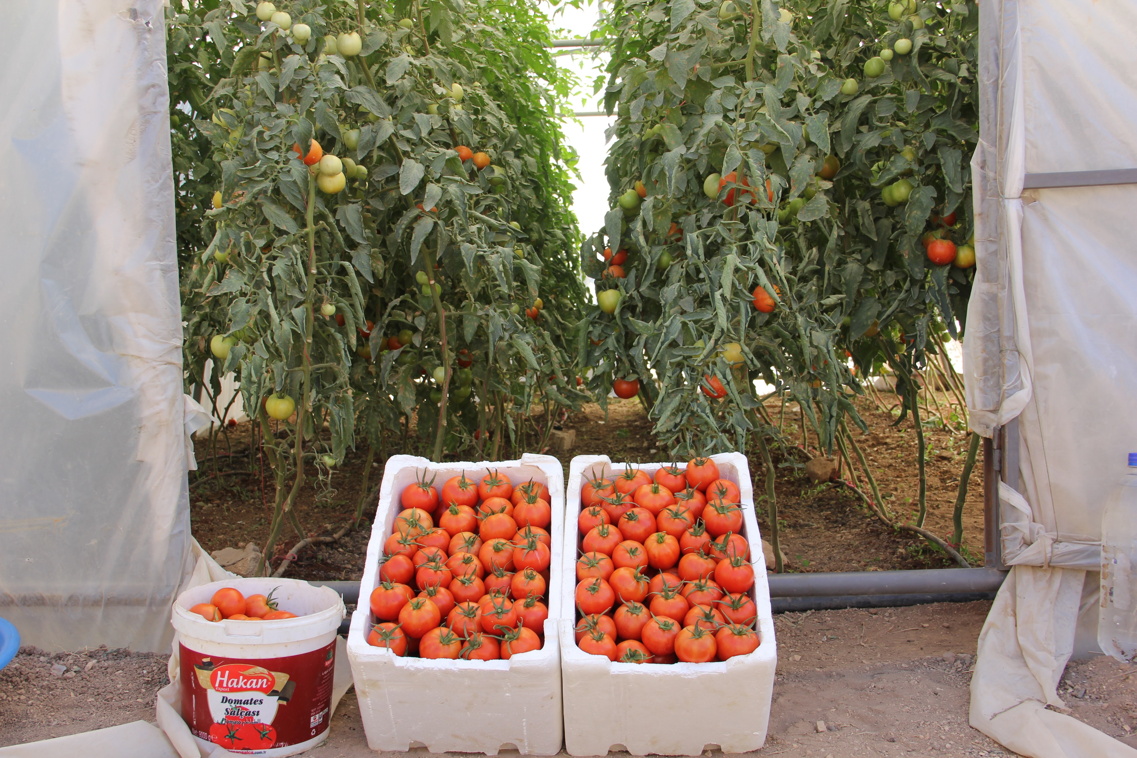
Tomatoes growing process

Slide 9
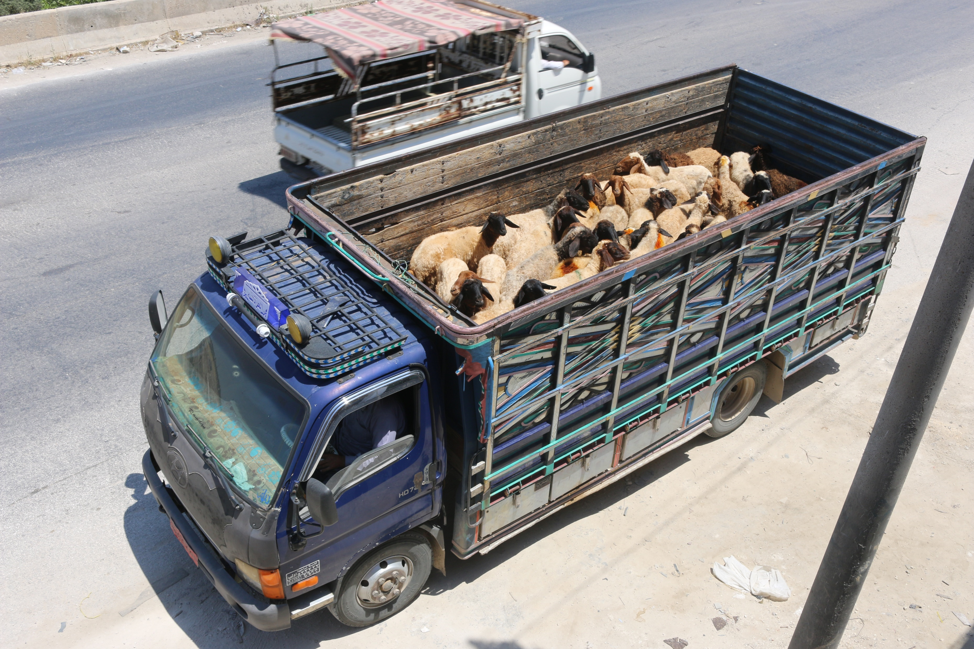
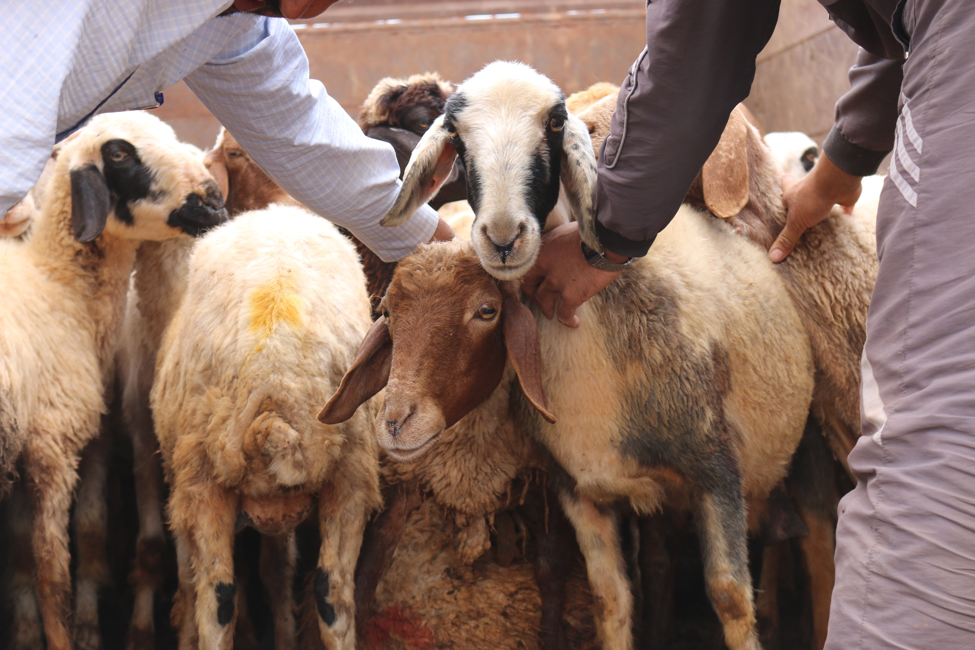
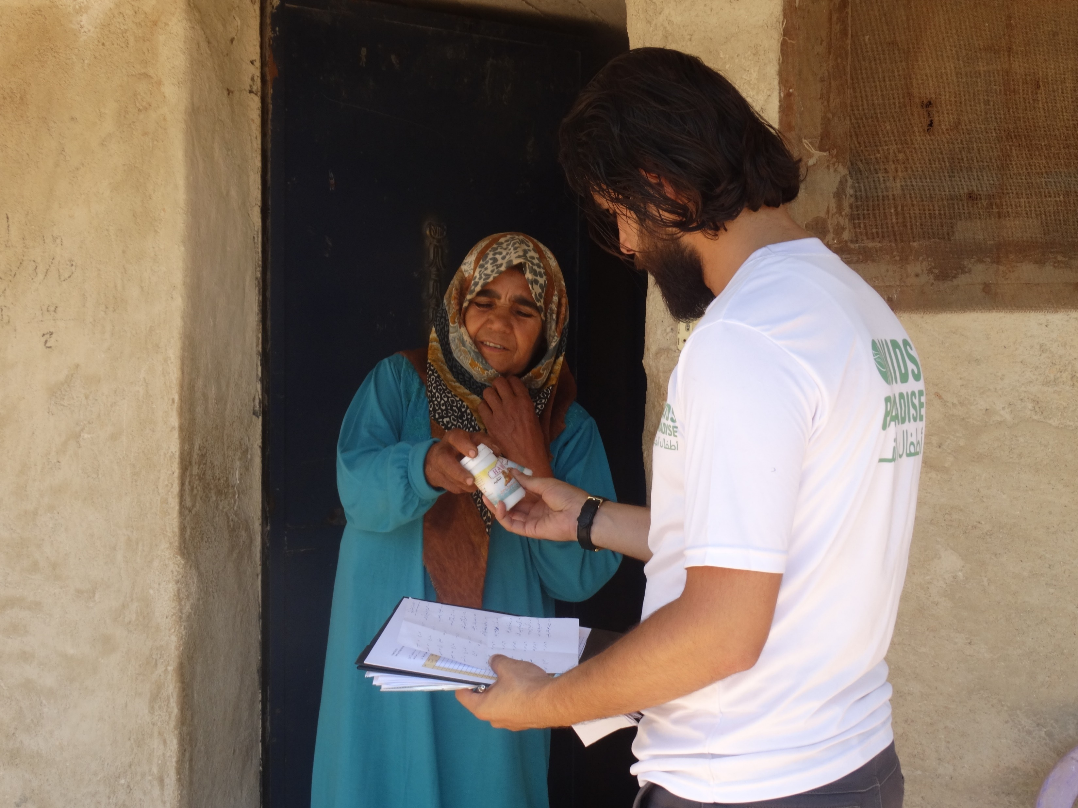
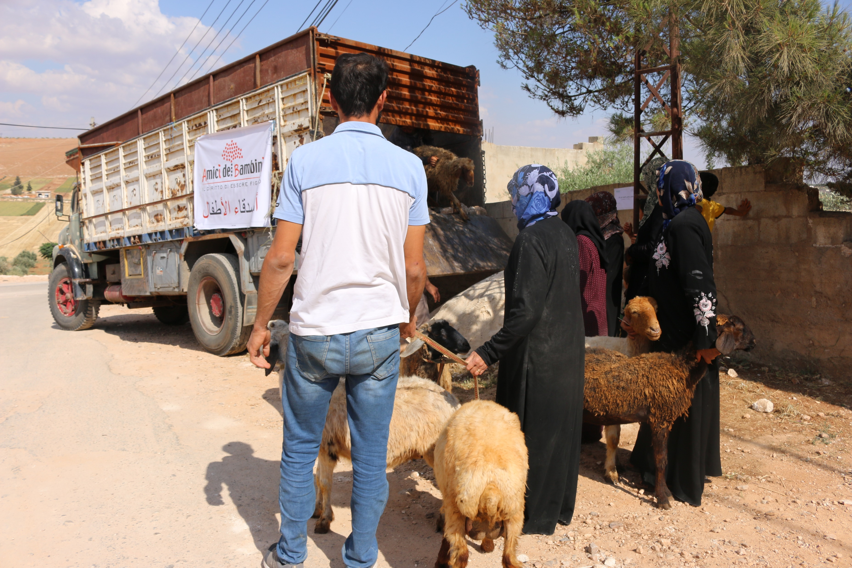
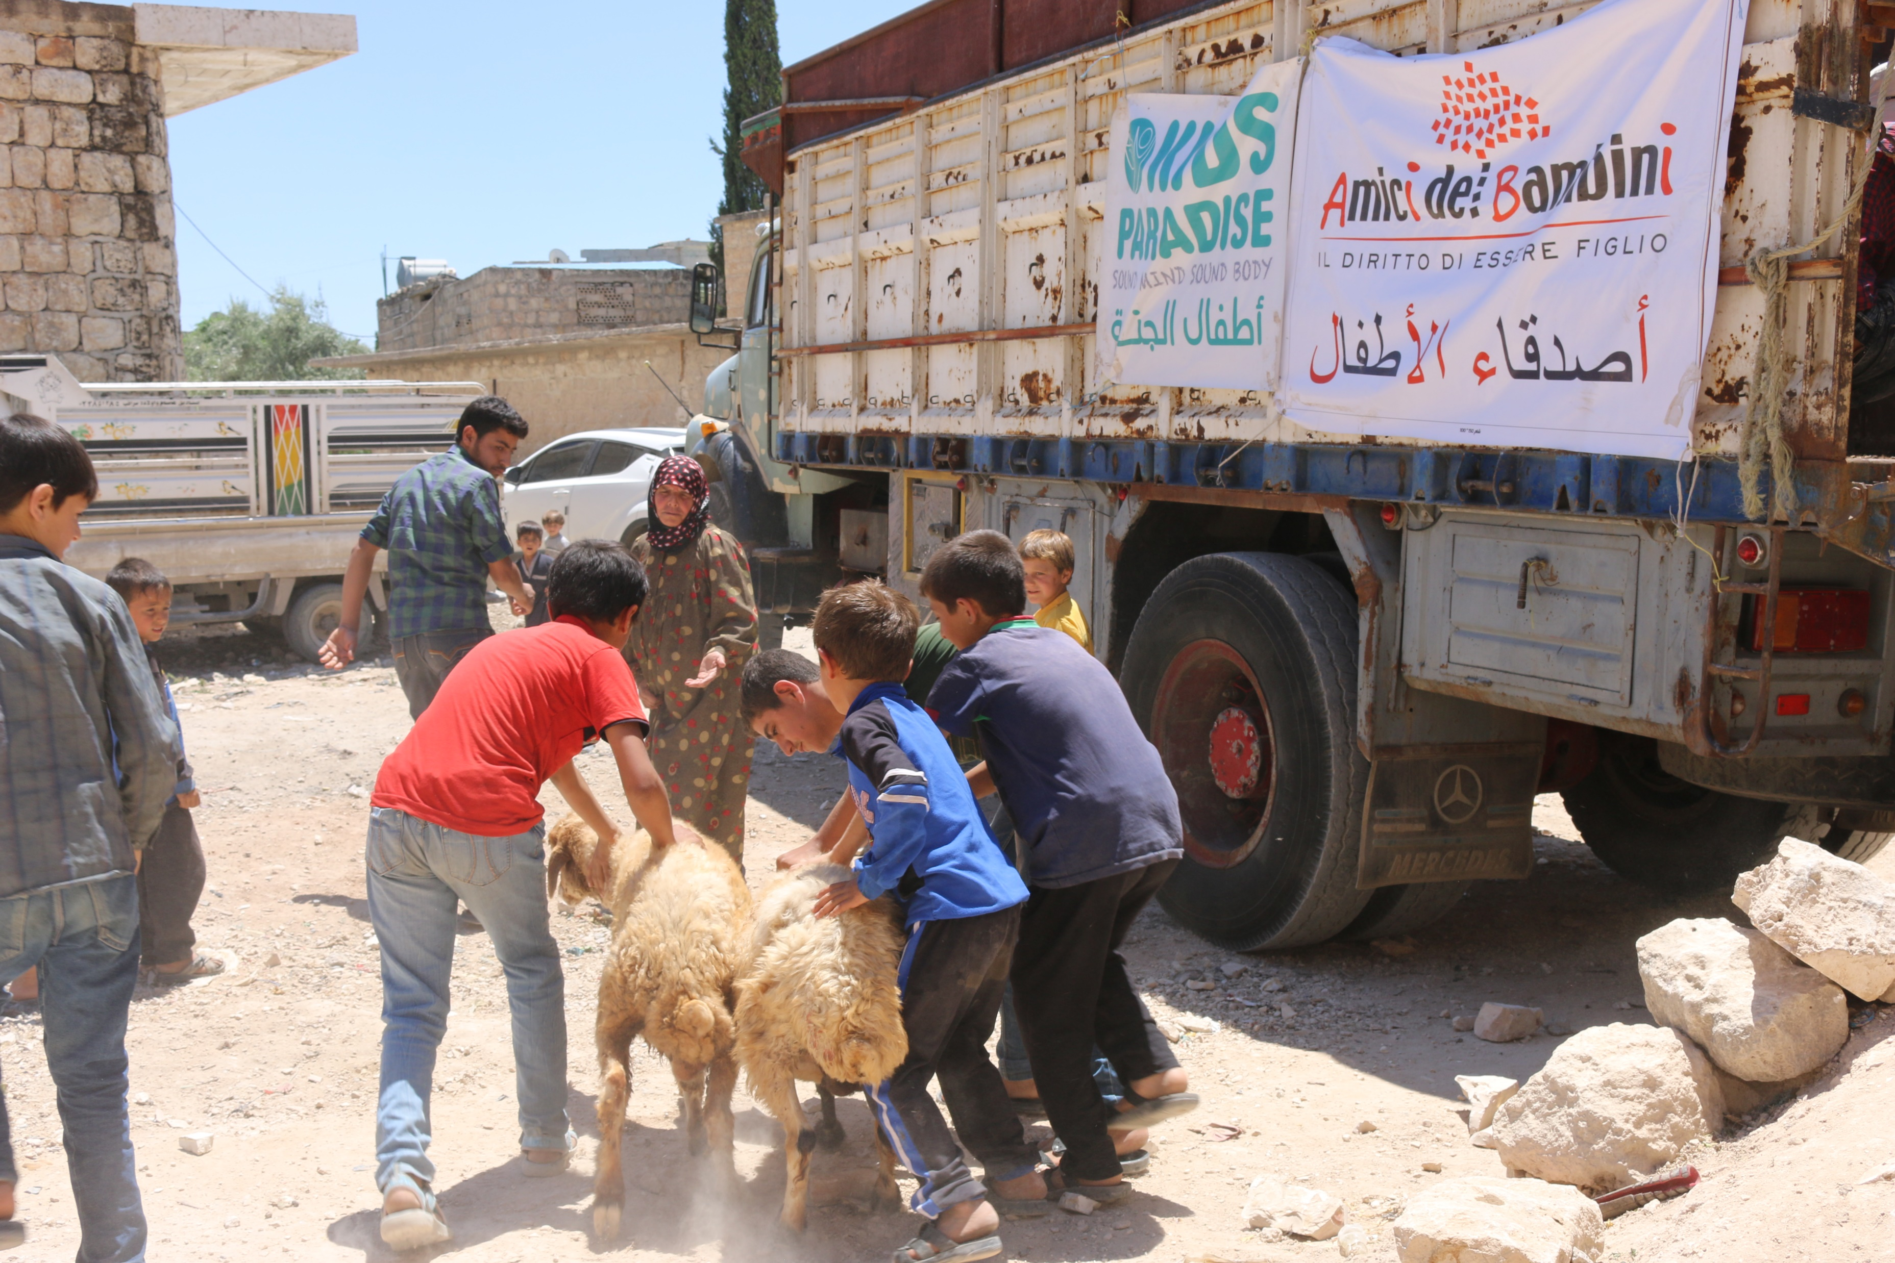
ACTIVITIES OF THE PROJECT
4) Distribution of:
360 sheep to 180 families and 200 cheese yeast tablets for each family.

Slide 10
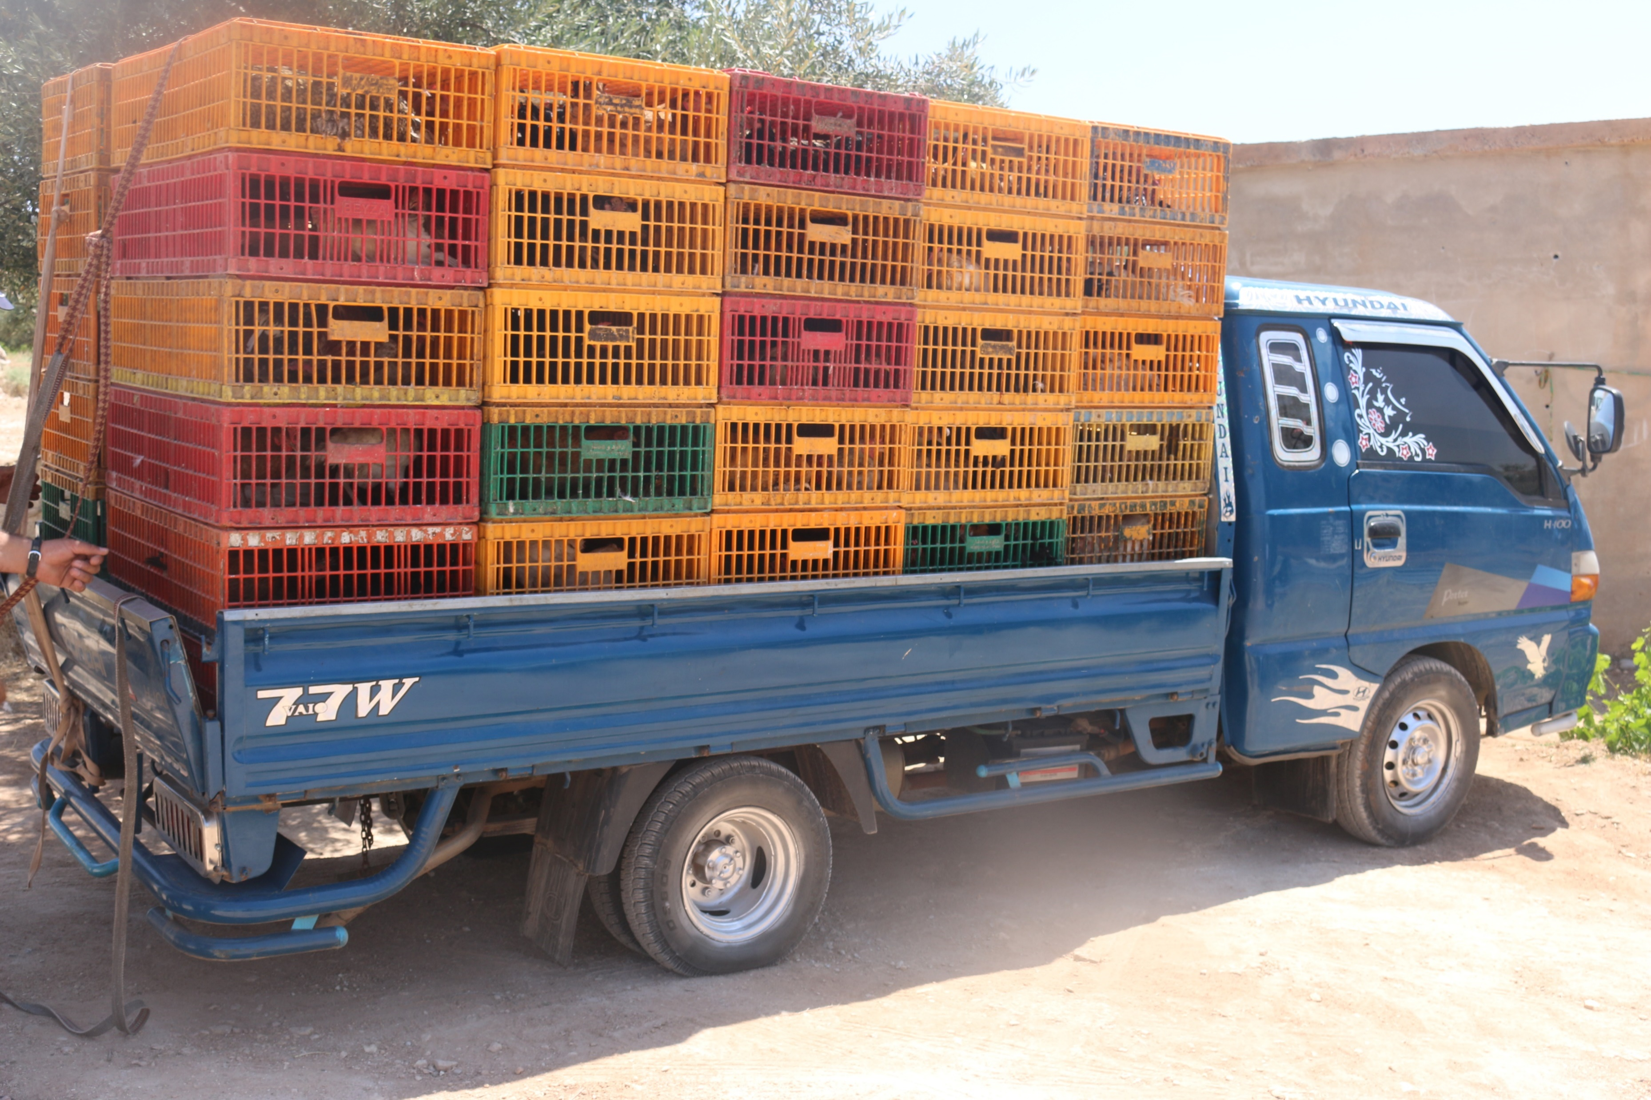
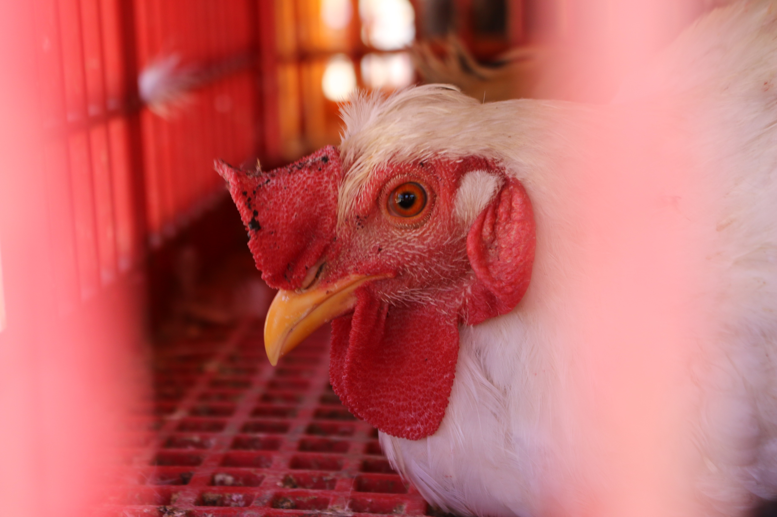
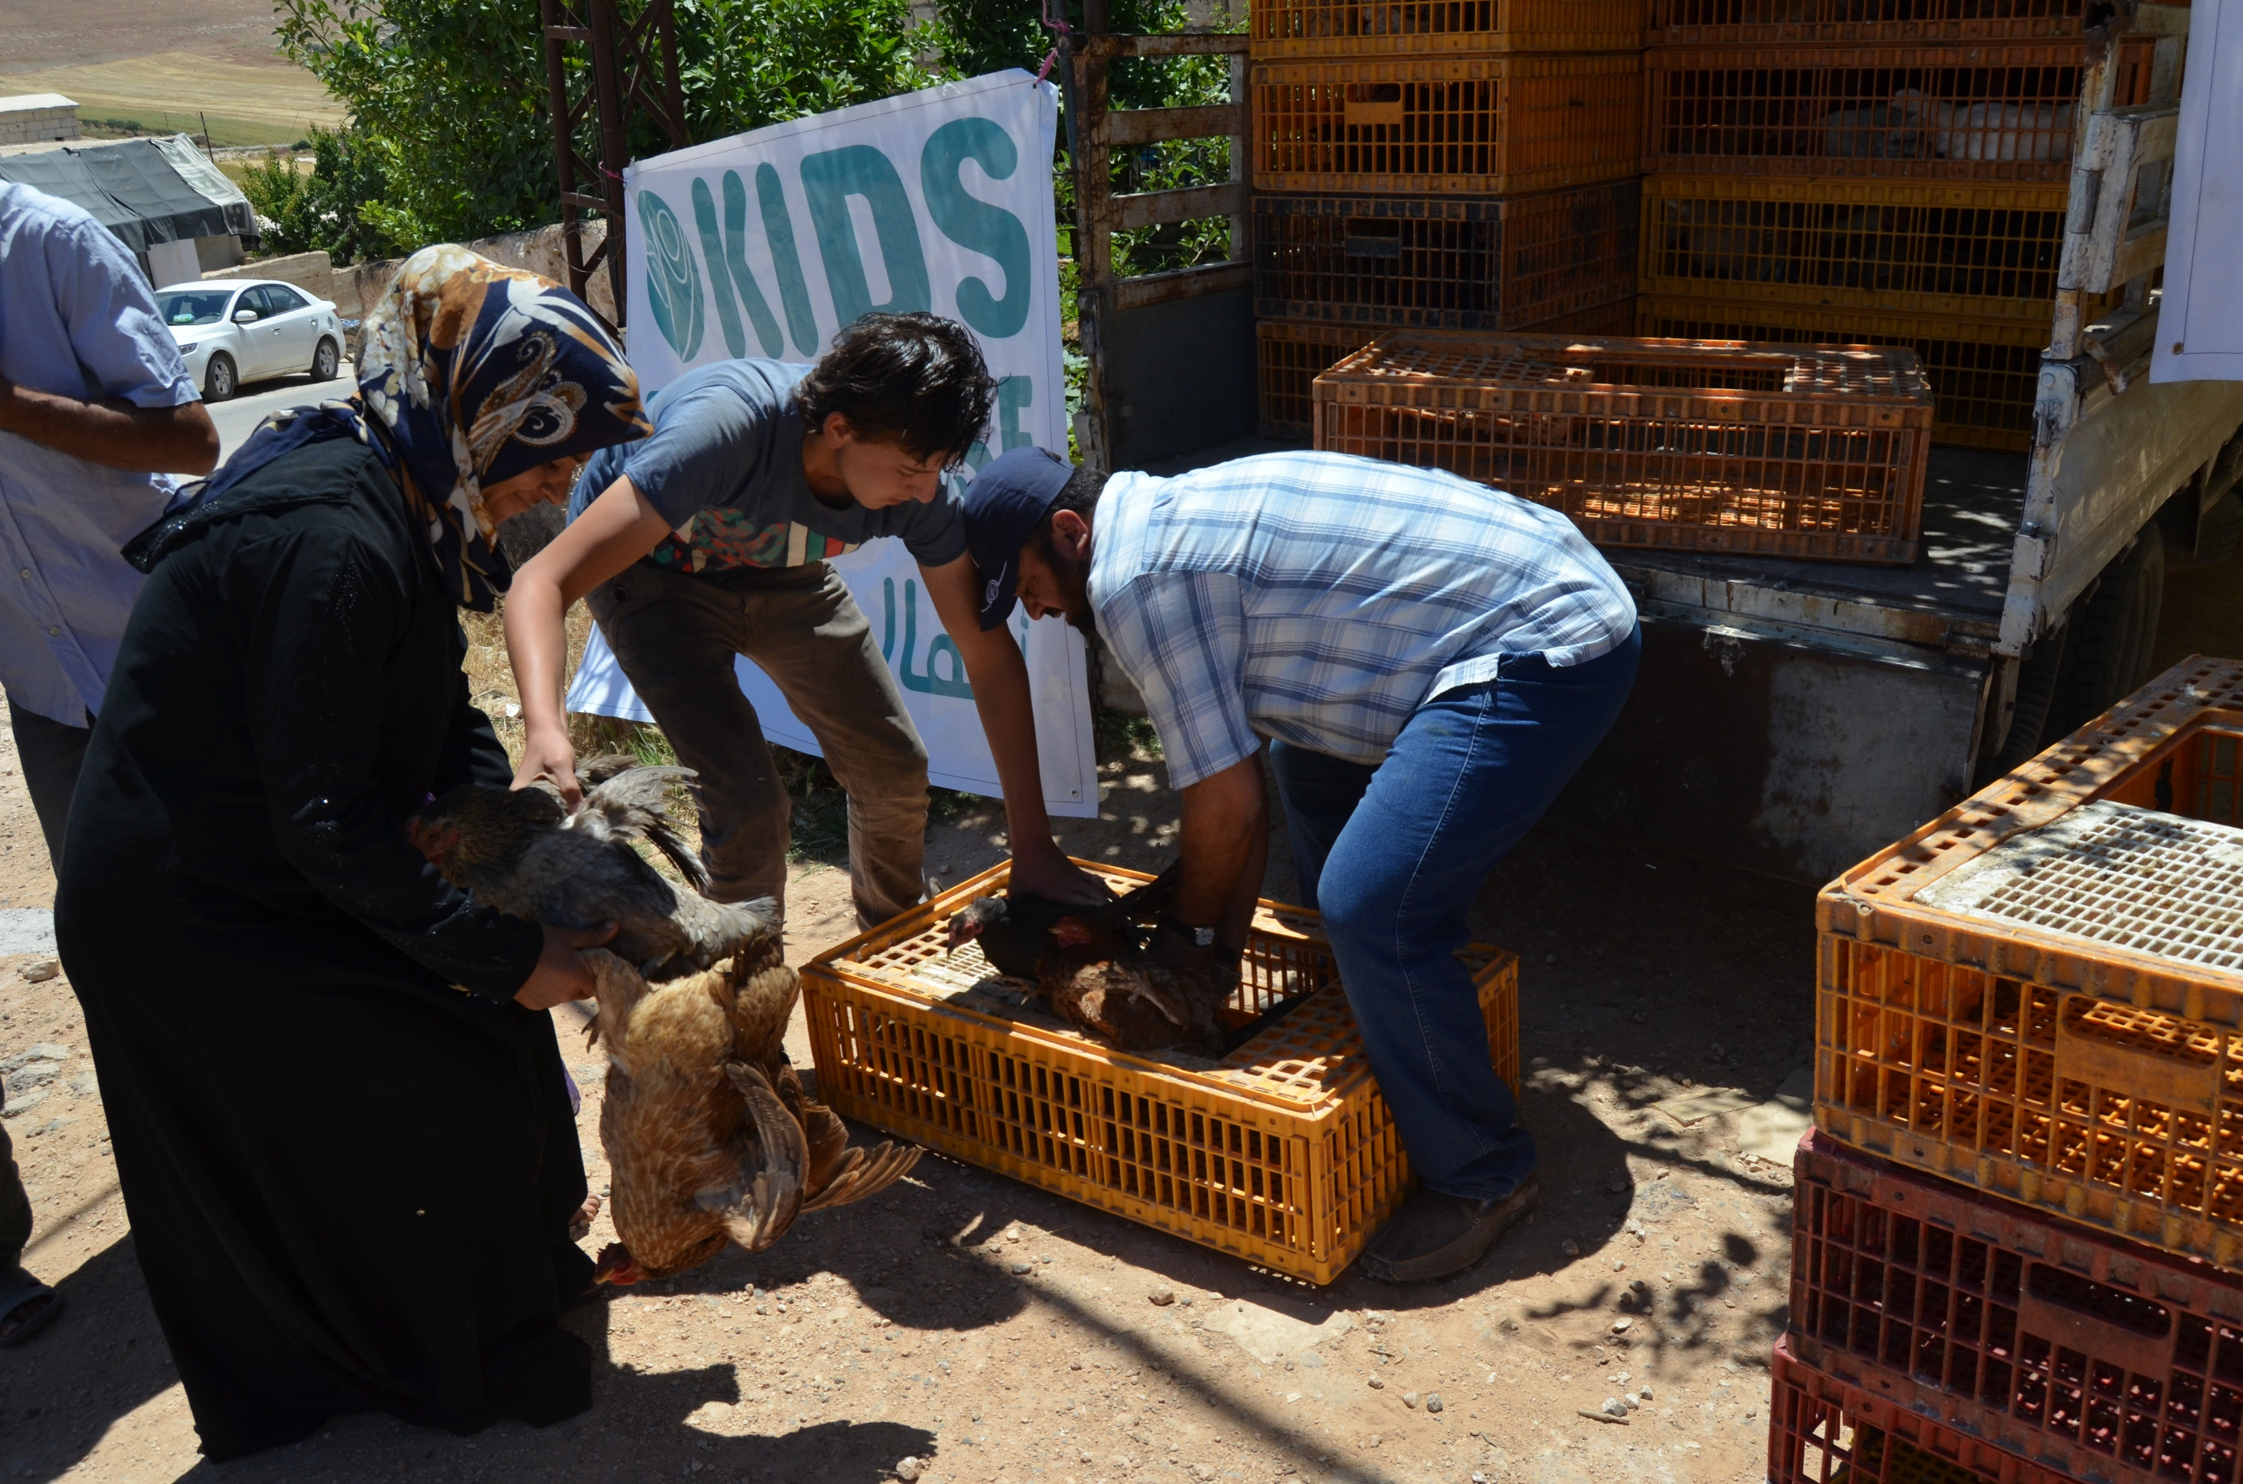
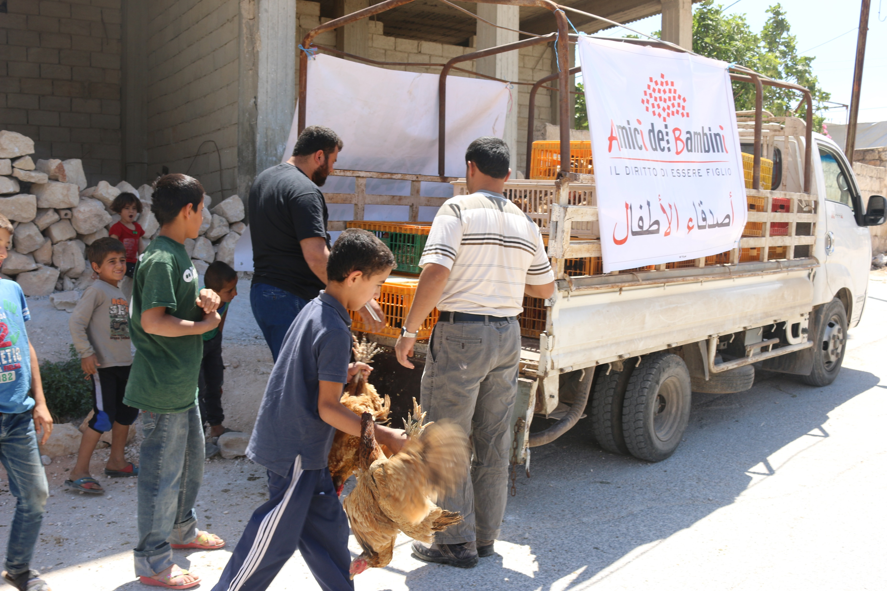
ACTIVITIES OF THE PROJECT
5) Distribution of:
1800 egg-laying chickens to 180 families.

Slide 11
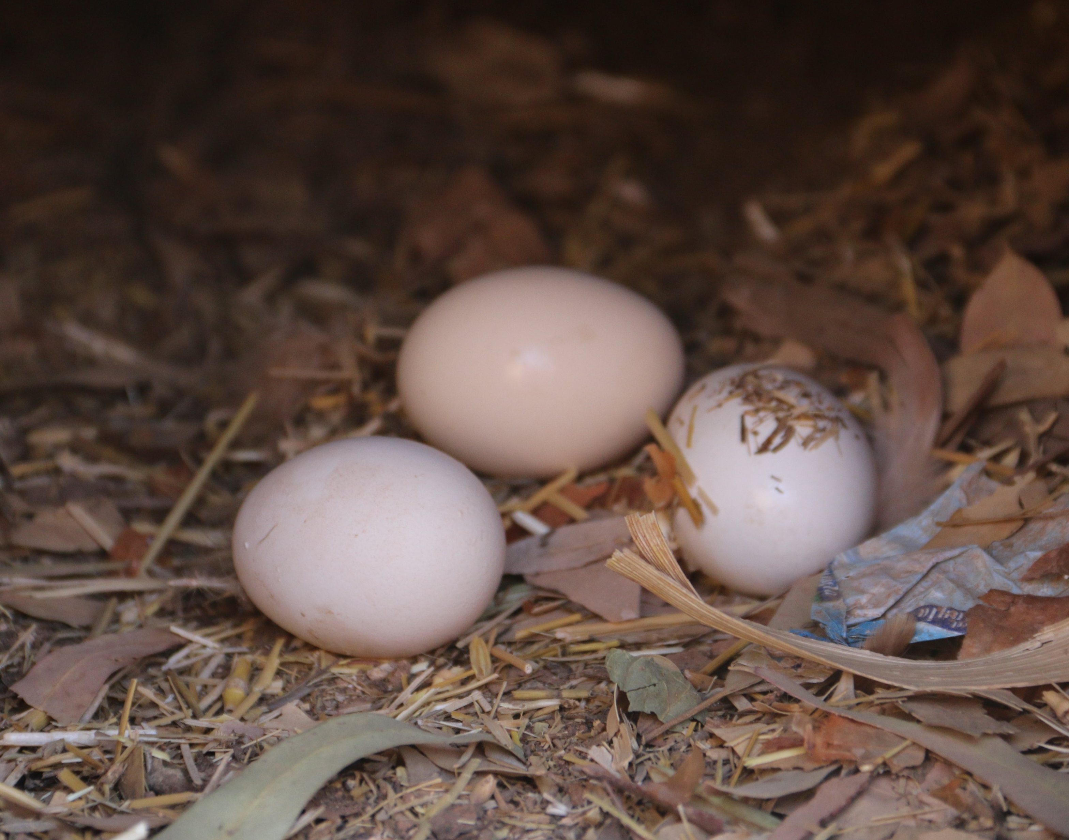
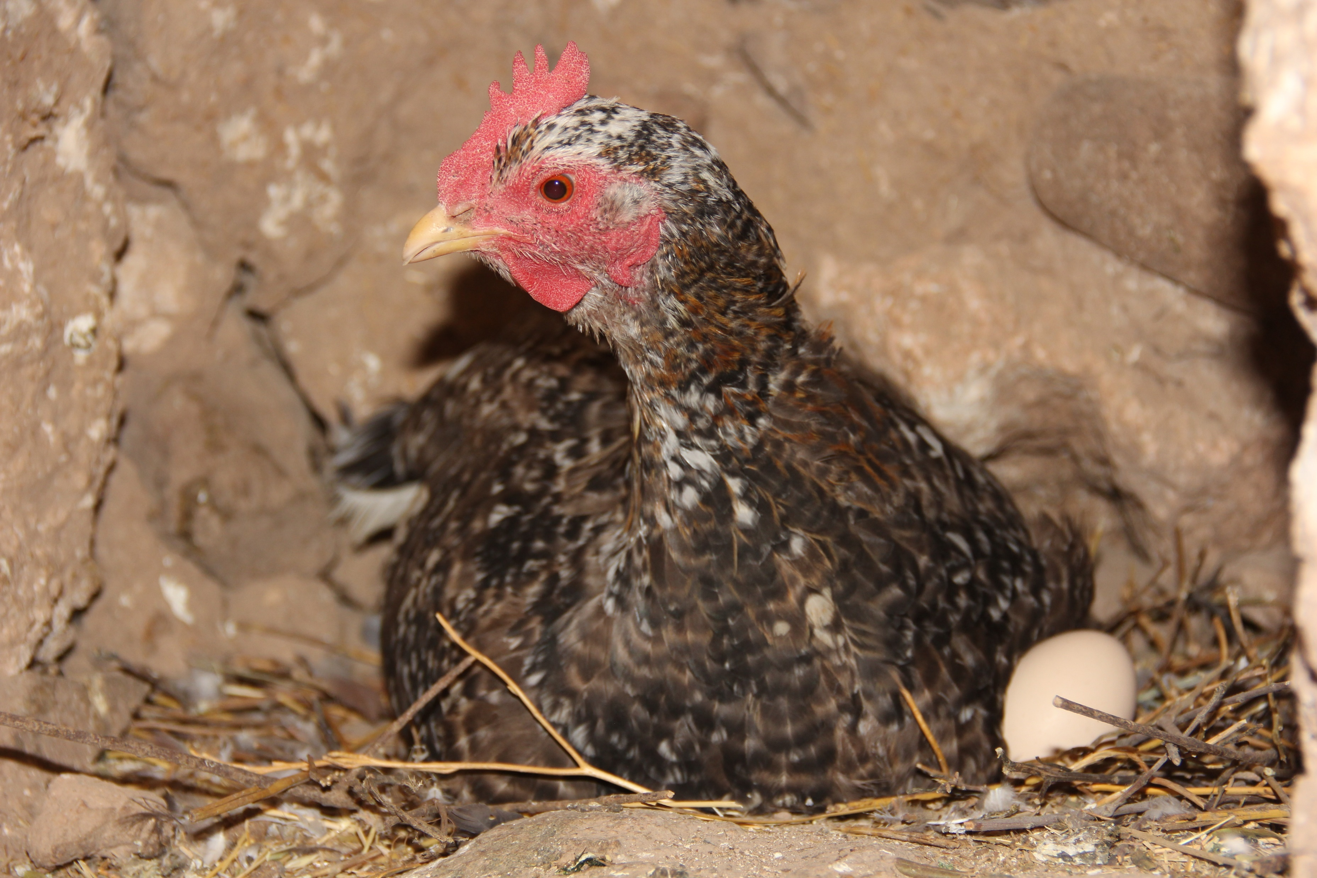
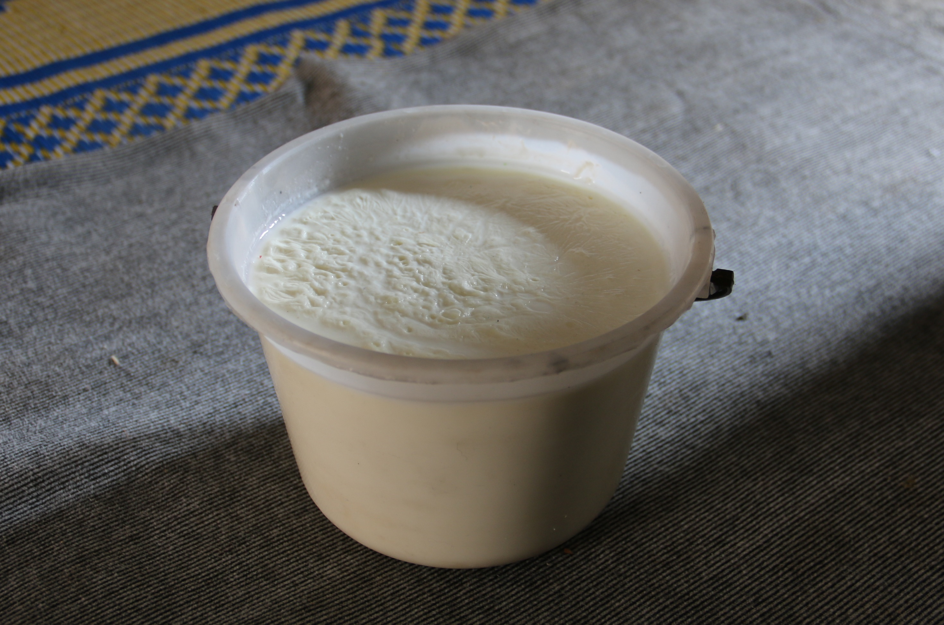
poultry and dairy products

Slide 12
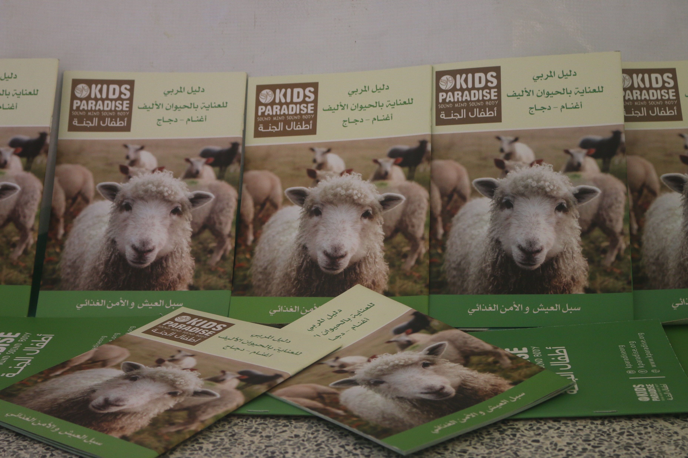
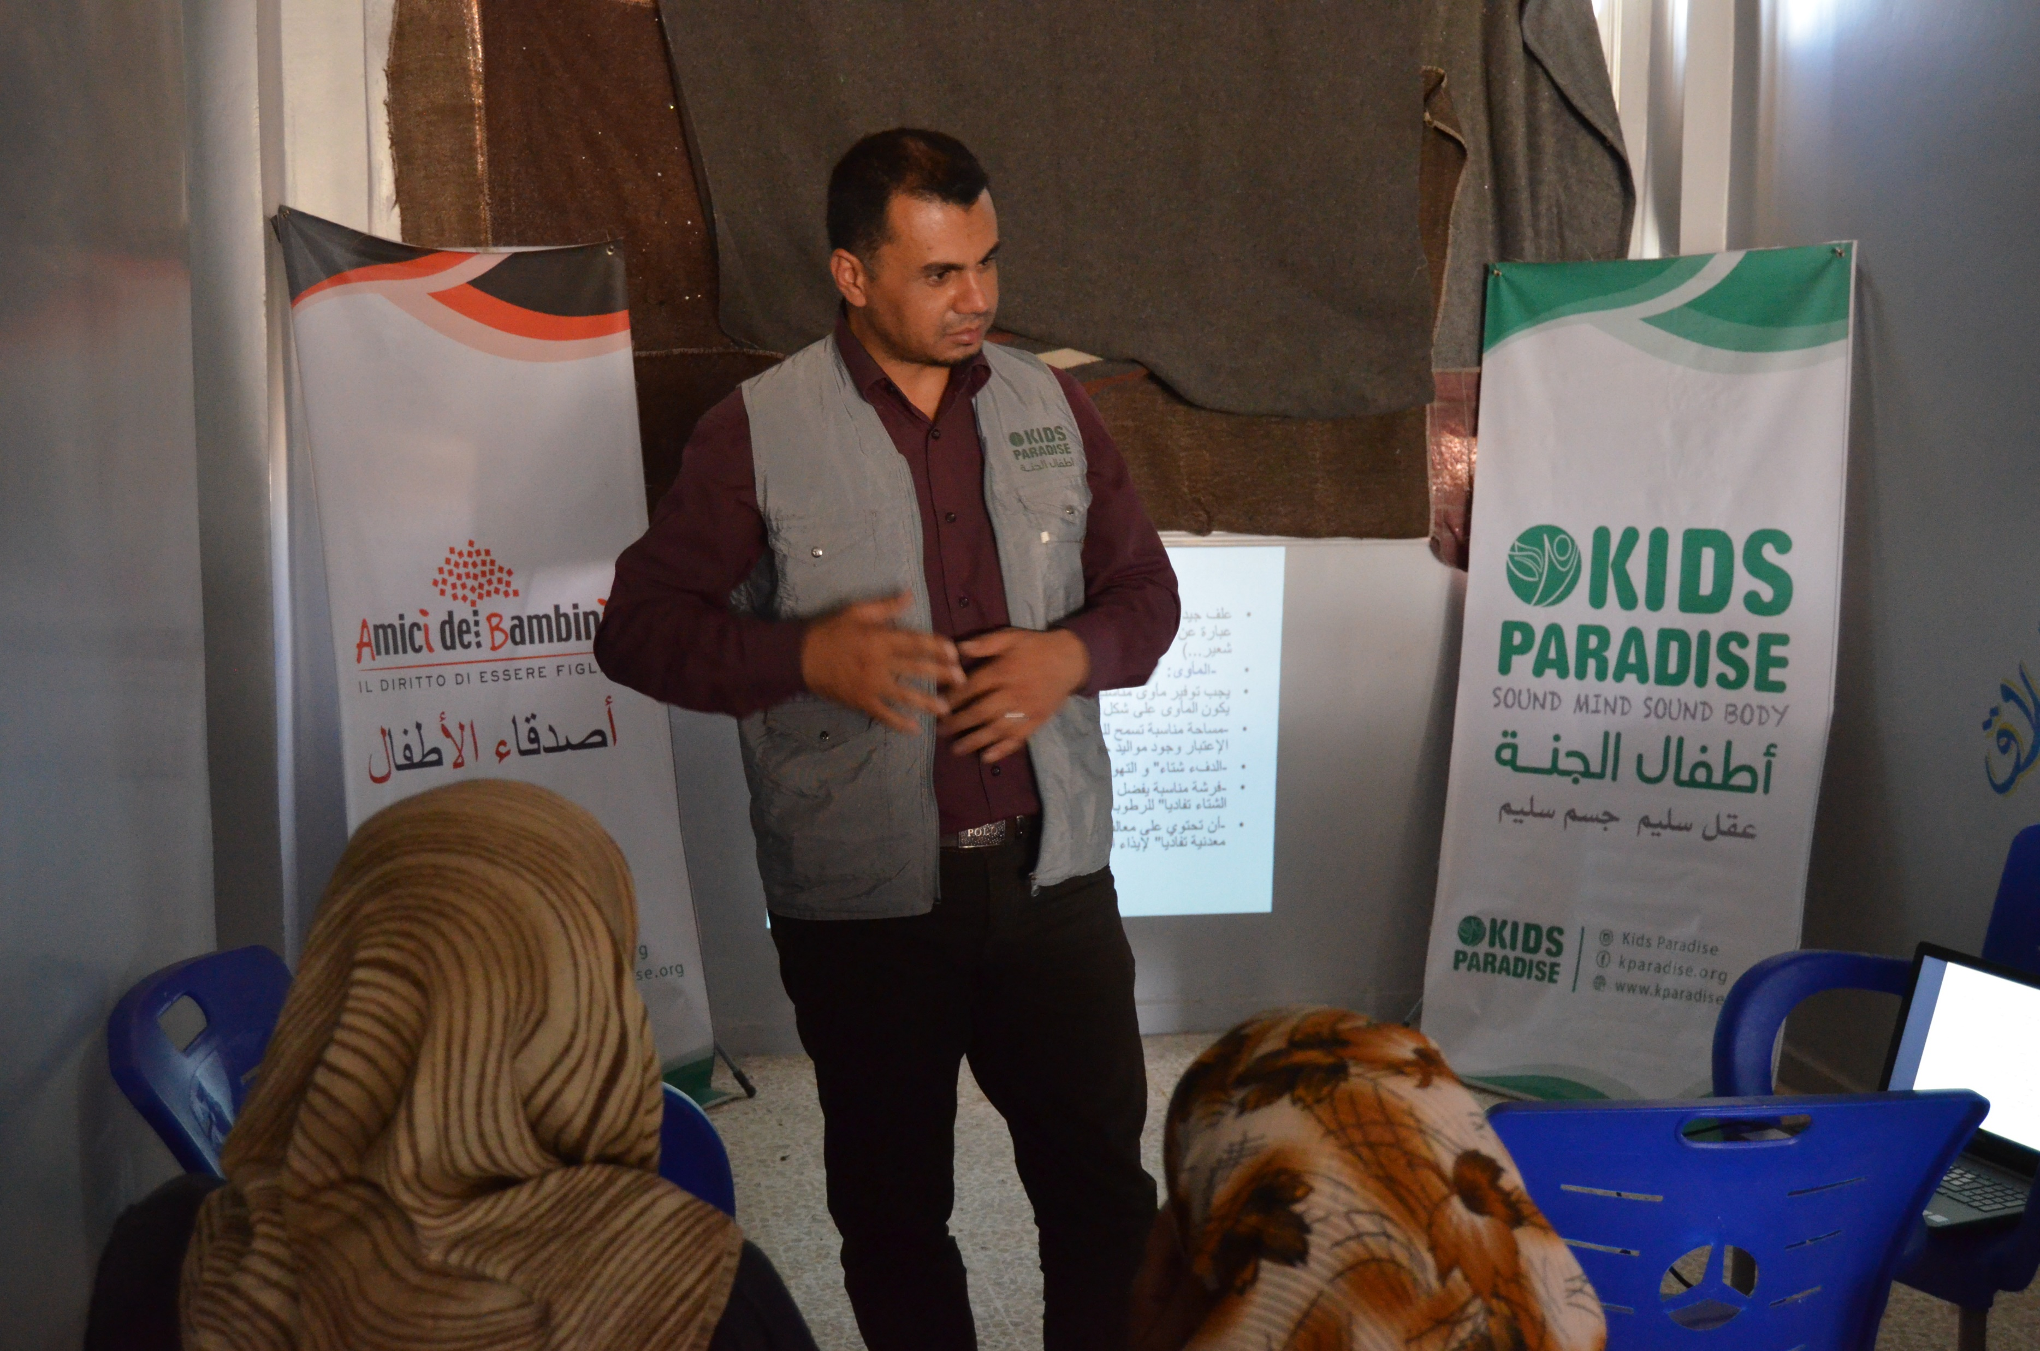
ACTIVITIES OF THE PROJECT
6) Vocational and technical training for the beneficiaries that included:
Agricultural training on:
a. Greenhouse agriculture.
b. Types of soil and when each one is used.
c. How to prepare the soil for cultivation.
d. Tomatoes cultivation process generally and in greenhouses.
e. Drip-irrigation systems and fertilizers purposes.
f. How to protect the crops from insects and pests.
g. Environment (Temperature – wind – humidity)
h. Greenhouse agriculture problems and solutions.
i. Harvest and marketing.

Slide 13
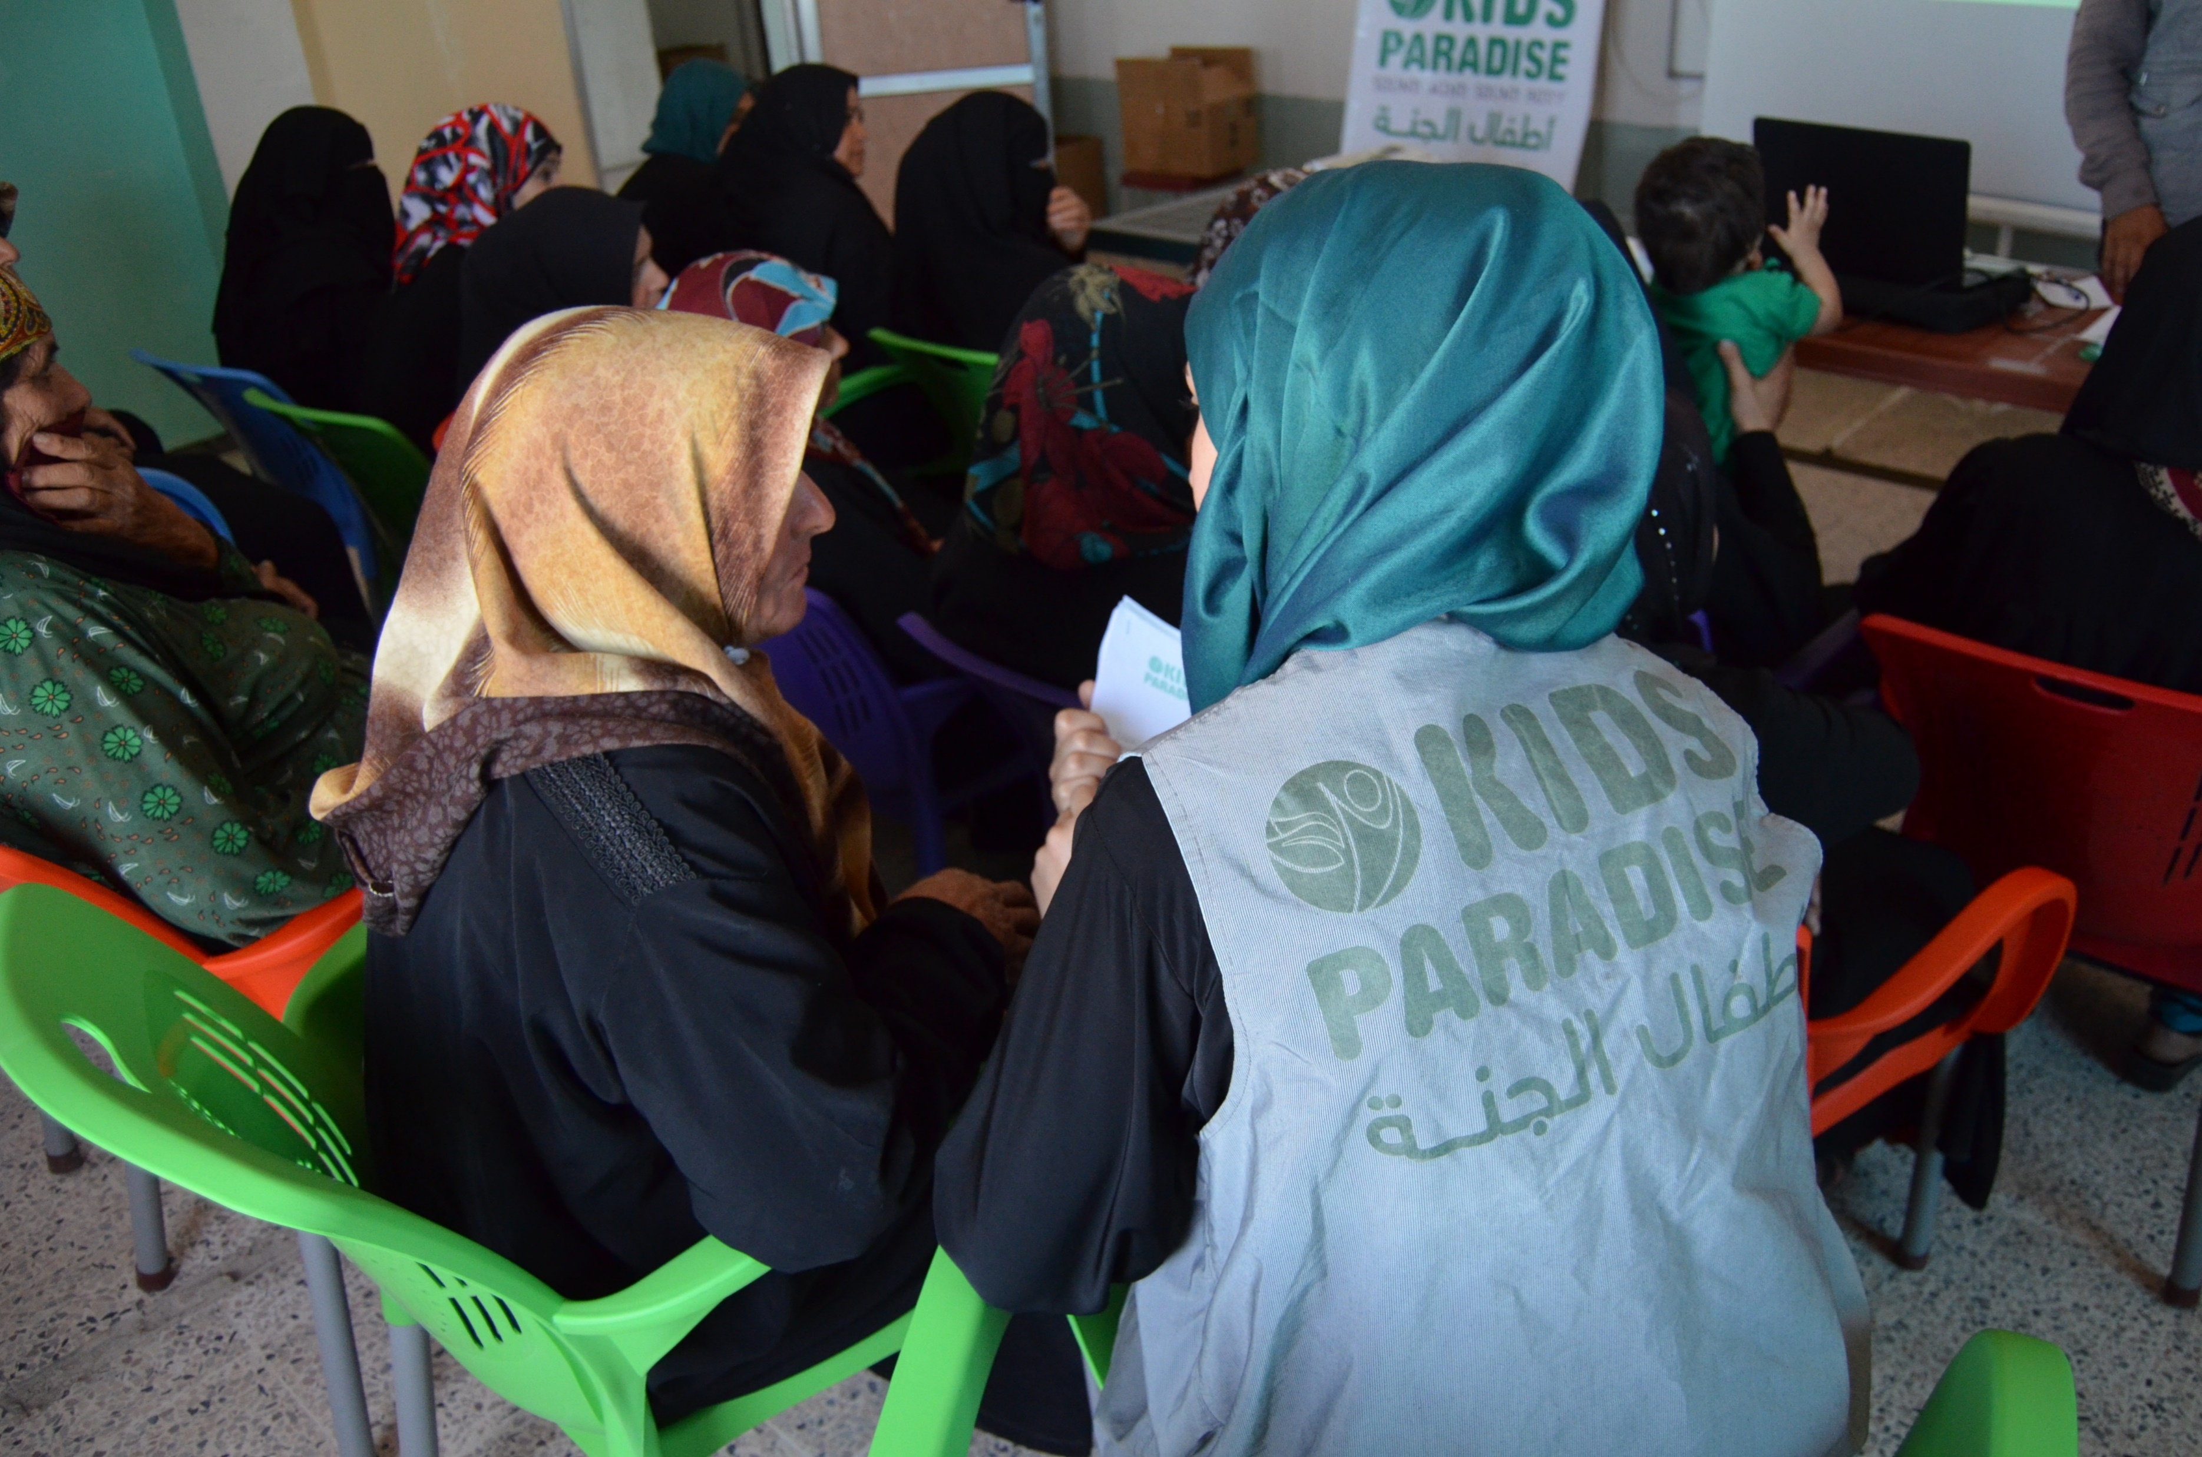
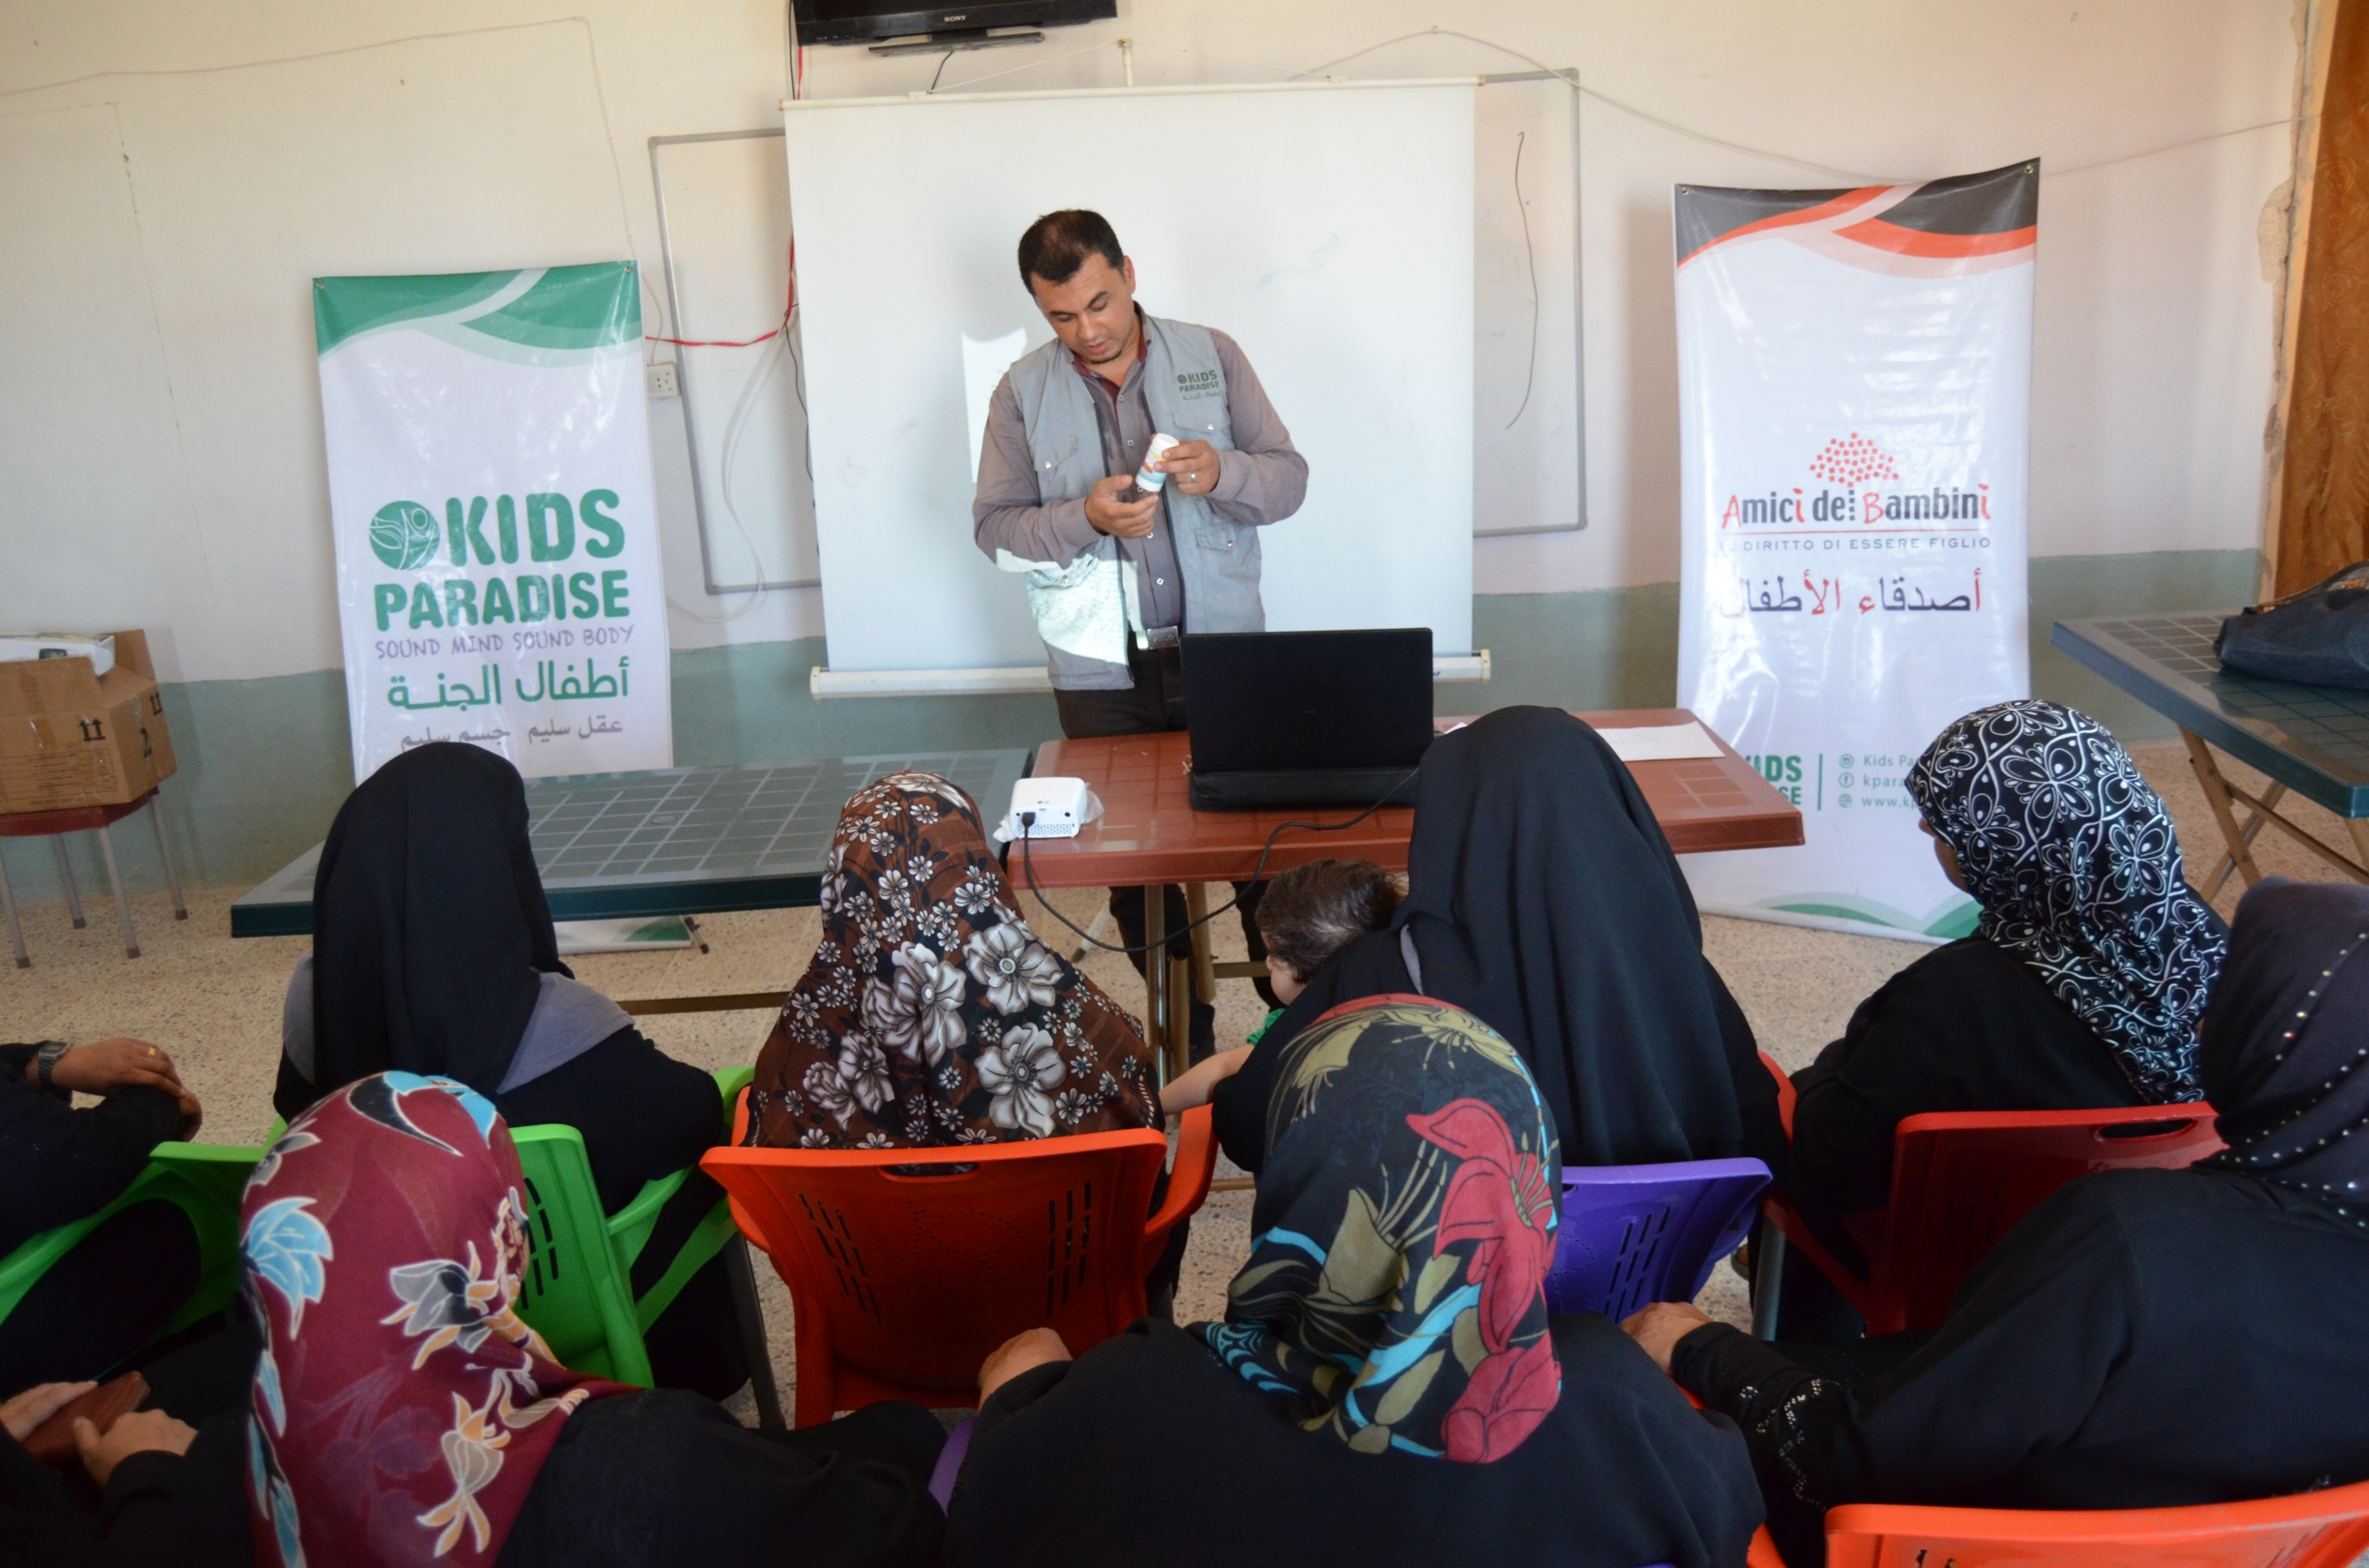
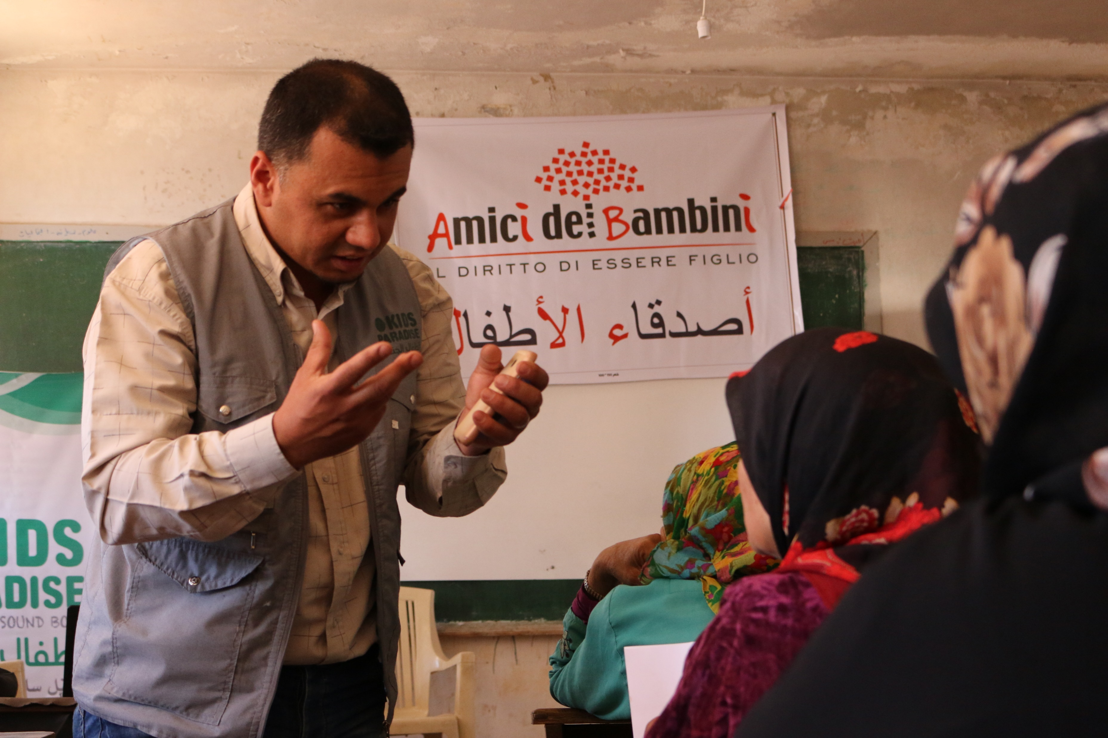
ACTIVITIES OF THE PROJECT
6) Vocational and technical training for the beneficiaries that included:
Training on livestock and poultry breeding that included:
a. Proper feeding.
b. Diseases and vaccinations.
c. Dairy and egg production.
d. Communicable diseases to humans.
e. The appropriate climate for livestock and poultry.

Slide 14
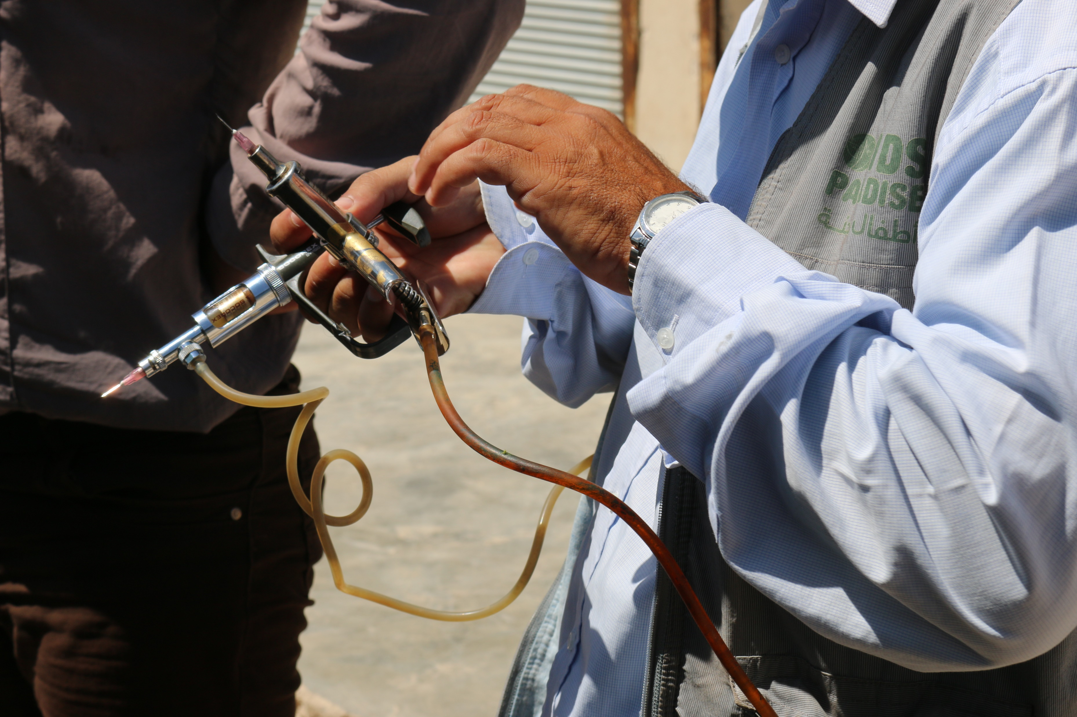
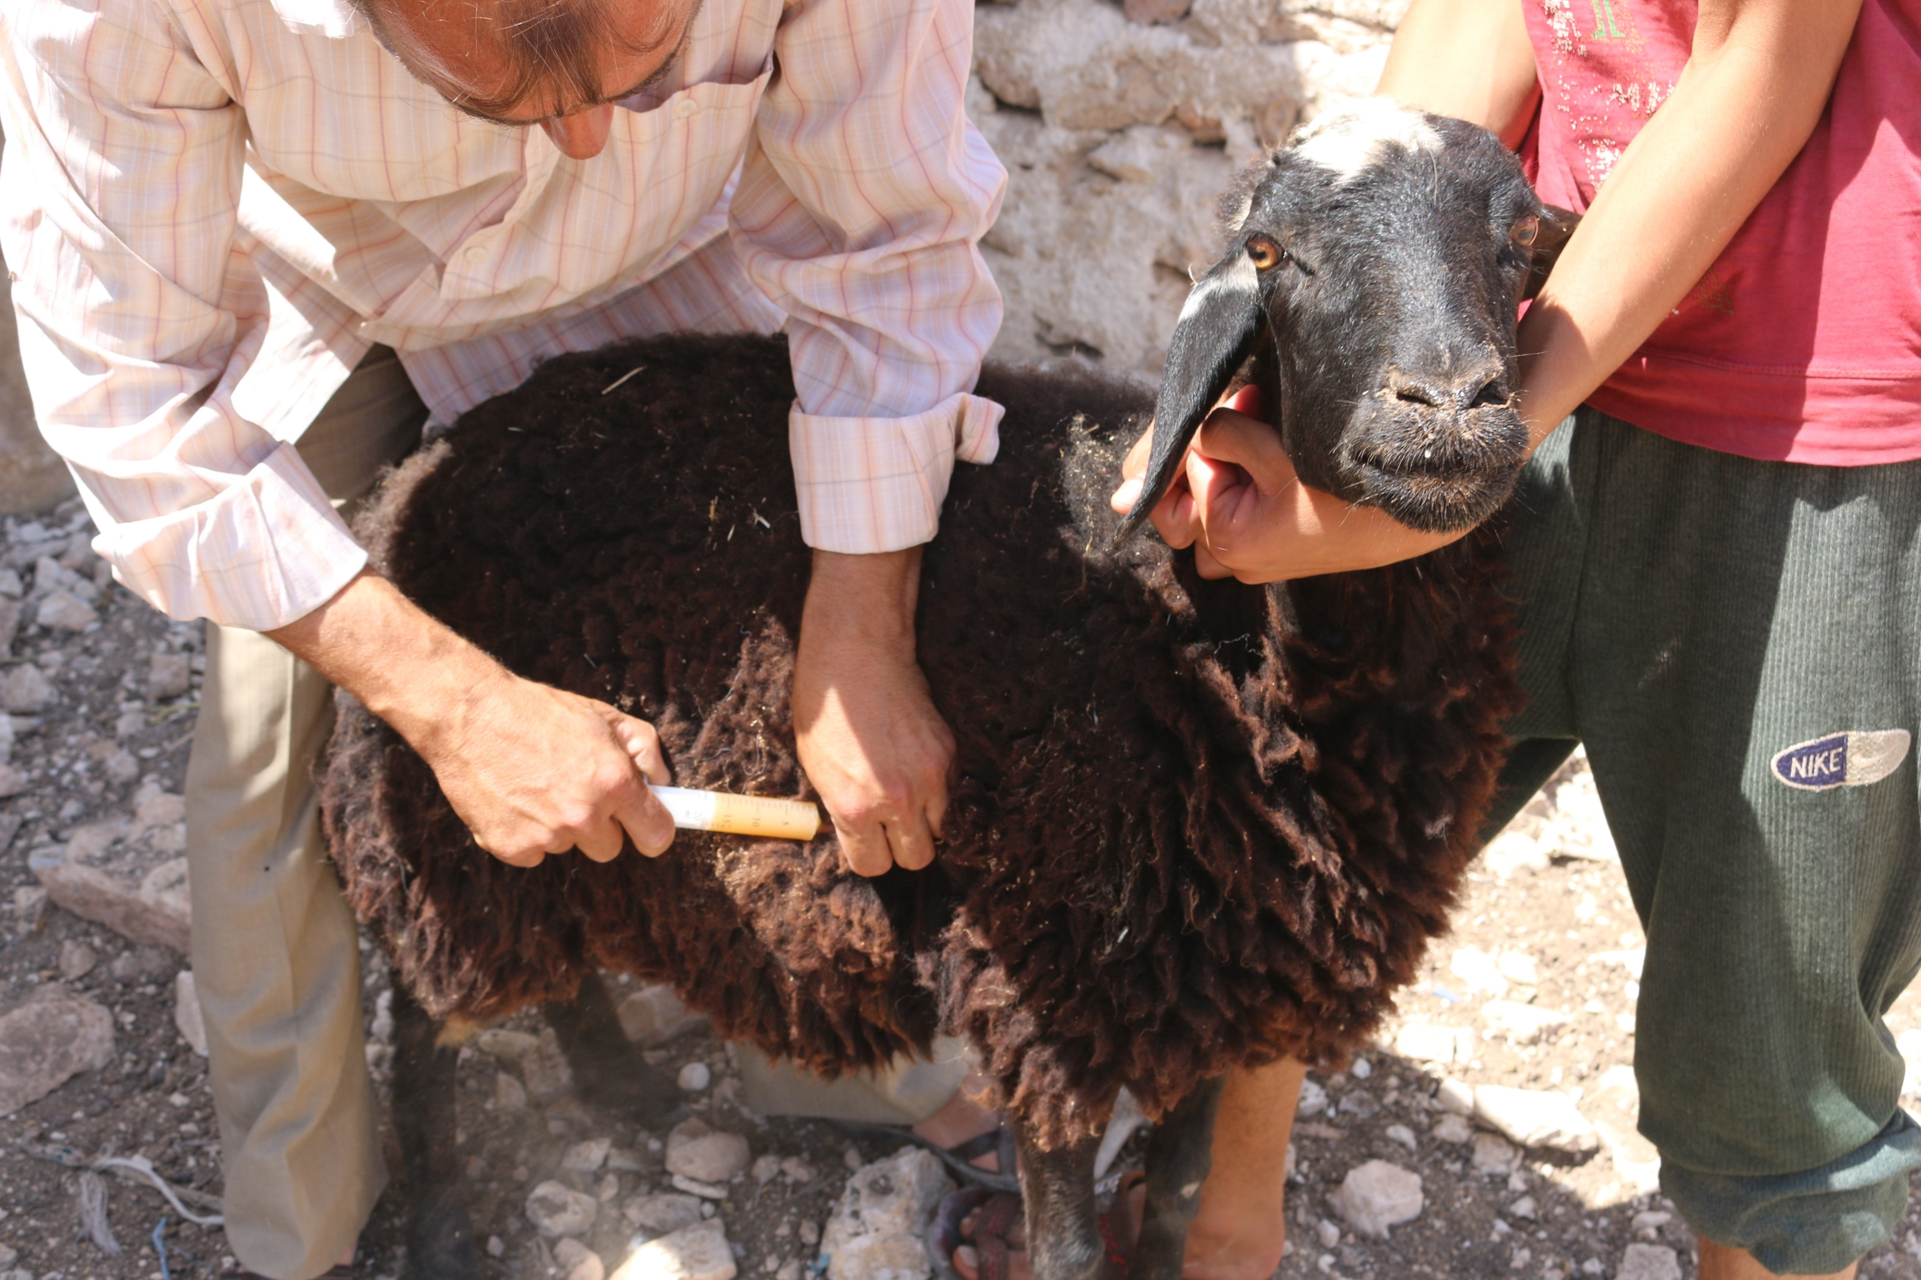
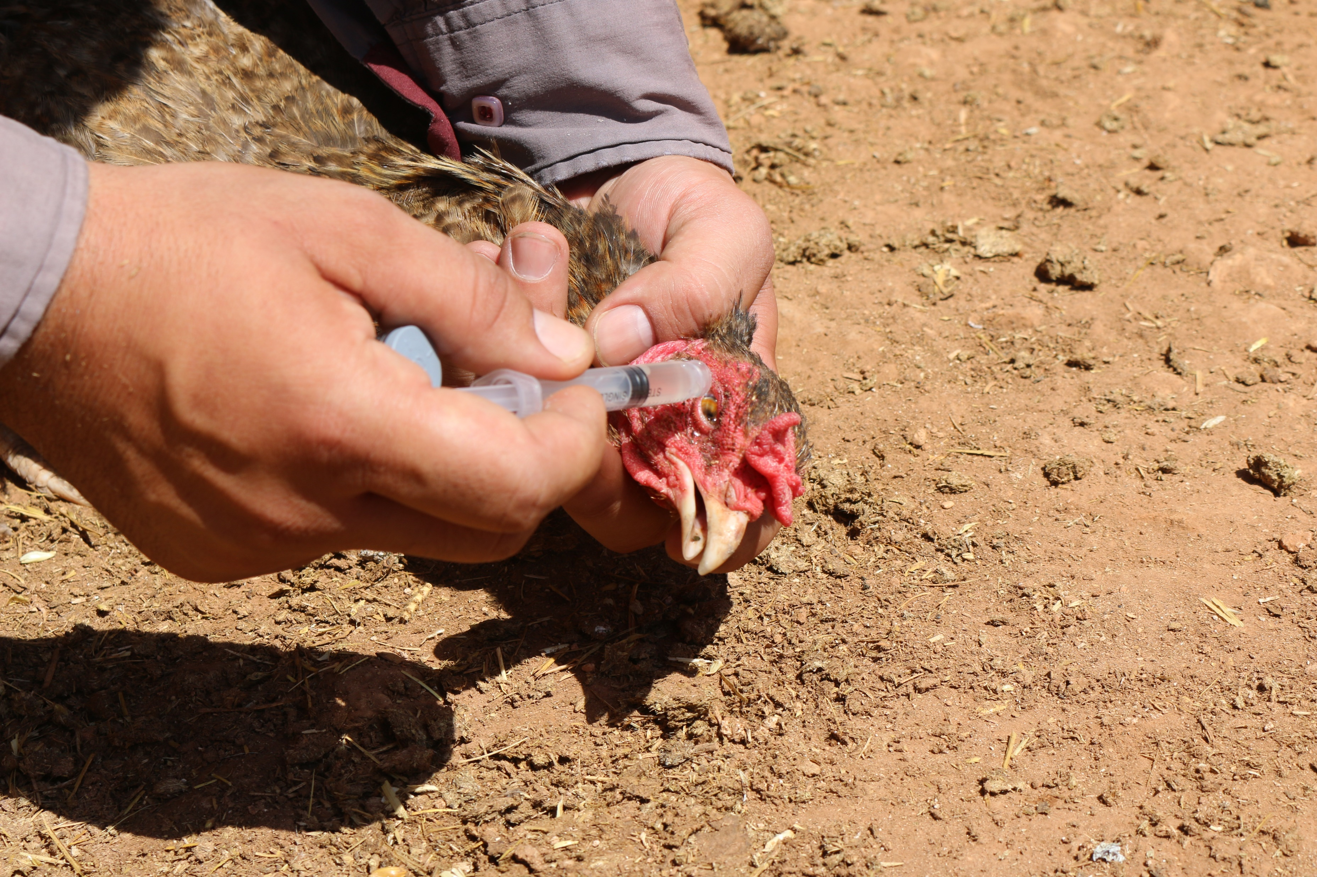
7) Two vaccination campaigns: for 16,400 sheep and 3,000 chickens each, via mobile clinic that covers the area targeted by the project, plus the distribution of veterinary baskets.
ACTIVITIES OF THE PROJECT

Slide 15
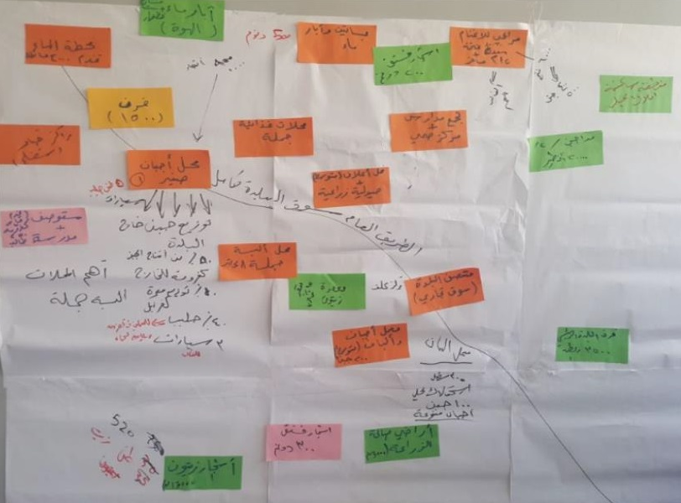
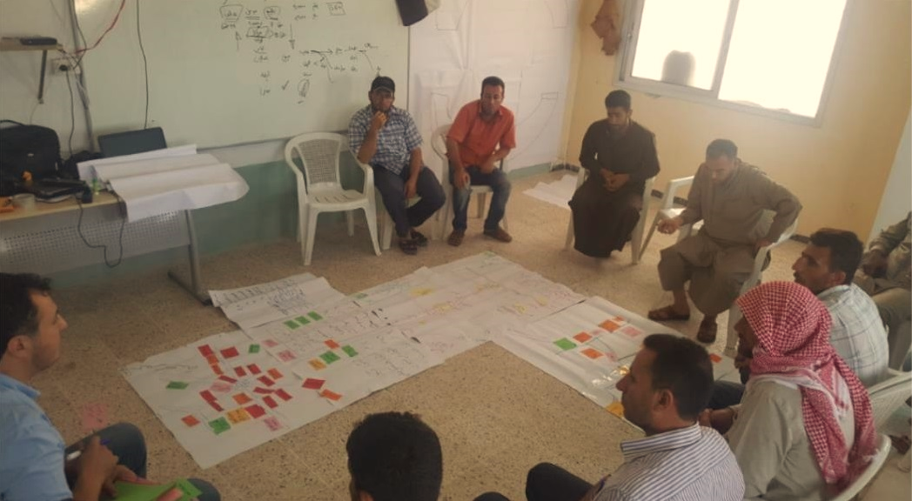
ACTIVITIES OF THE PROJECT
8) In depth assessment of local markets in the targeted area to
identify the economical problems and contribute to the overall
economy by creating new income supporting projects for indigent families.

Slide 16
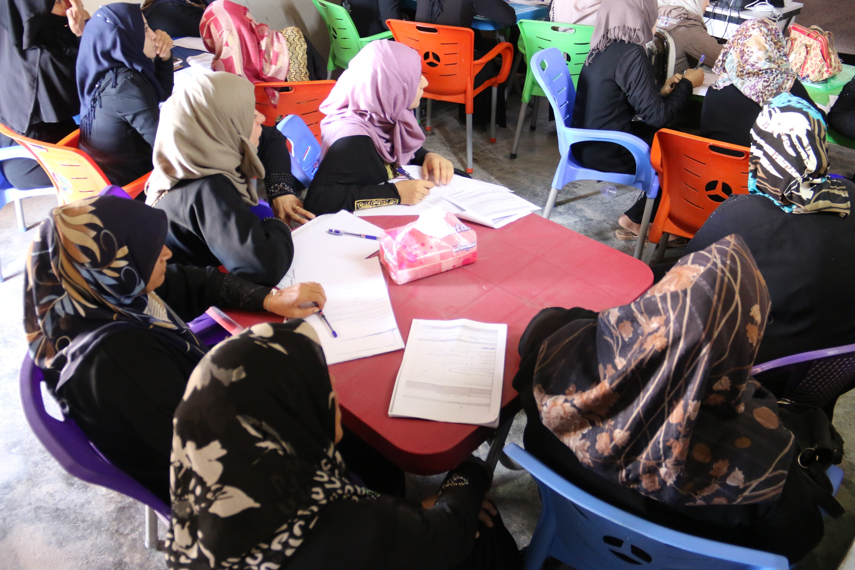
ACTIVITIES OF THE PROJECT
9) Small business management courses for 90 women who are interested in starting their own income generating projects.

Slide 17
Thank You!
www.kparadise.org

